Slide 1

Can we trust test results?
Guido Makransky
Senior pychometrician: Master Management International
Ph.D. student: University of Twente, Holland

Slide 2

Overview
Difference between maximum potential and self report tests
Maximum potential (e.g. ability tests)
  Is cheating a problem?
  Methods used to limit/catch cheaters
  Example of a confirmation test
Self report (e.g. personality tests)
  What is faking/impression management?
  How widespread is faking and is it a problem?
  Methods used to limit faking
Discussion

Slide 3
Two fundamentally different types of tests
Measures of maximum potential
Self report measures of typical behavior
Cognitive ability test
IQ test
Achievement
Knowledge test
Certification test
Personality test
Mood test
Emotional intelligence test
Typology
Integrity tests
Opinion survey

Slide 4
Important distinctions in terms of cheating:
Maximum potential vs. reported behavior
Are answers scored as correct/incorrect?
Can perfect supervision prevent deception?
In a maximum potential test the issue is cheating
In a self report test the issue is faking

Slide 5

Tests of maximum potential
  Cheating: an attempt, by deception or fraudulent means, to represent oneself as possessing knowledge that one does not actually possess (Cizek, 1999, p.3)
  Is cheating a problem?
    45% of job applicants falsify work histories (Burke, 2009)
    About half of all college students report cheating on an exam (Cizek, 1999)
    Security issues were outlined as the most serious concern for testing organizations (Association of test publishers conference, 2011)

Slide 6
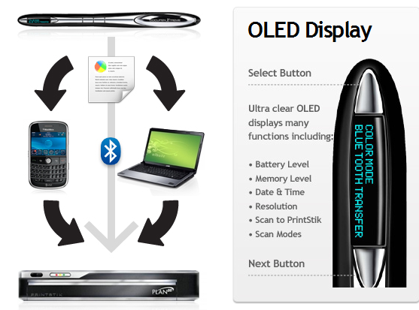
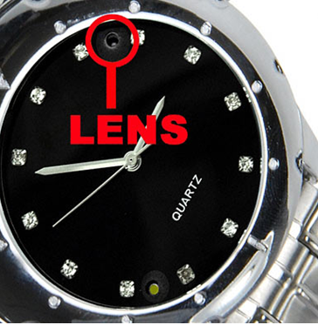
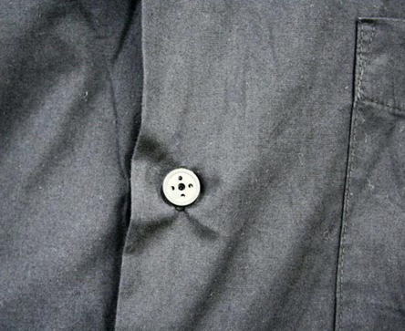
Examples of cheating tools

Slide 7

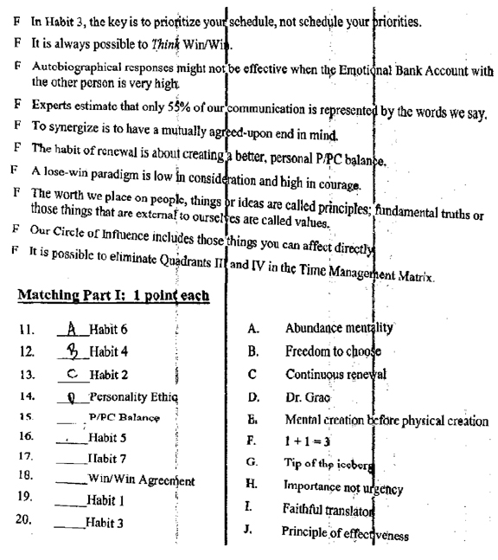
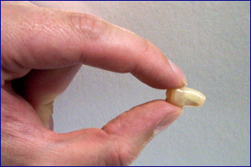
Examples of cheating tools

Slide 8
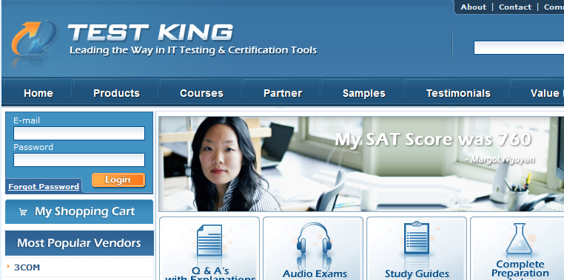
Examples of cheating tools

Slide 9

Cheating risk factors
The stakes of the test: high vs. low stakes
The size of the test program: large vs. small
How well known is the testing procedure?
Culture
Age?
  Recent studies report age is a significant predictor of cheating, with younger students cheating
  more than their older peers (Diekhoff; Graham and Haines).

Slide 10

Traditional method to stop cheating = Proctoring
Does proctoring work?
Fishbein (1994): Rutgers instructors as proctors caught less than 1% of cheaters
Haines et al. (1986) 1.3% of undergraduate cheaters are caught
Responses of faculty that personally witnessed cheating (Jendrek, 1989):
  67% discussed with student
  33% reported it
  8% ignored it altogether
Murray (1996) reported that 20% of professors ignored obvious cheating

Slide 11
When there is no control cheating increases
Some proctor correlates of cheating:
  Decreased level of surveillance by proctor (Covey et al., 1989)
  Unproctored examination (Sierles et al., 1988)
  Instructor leaving the room during testing (Steininger et al., 1964)
  Reduced supervision (Leming, 1978)

Slide 12

New challenges
Internet delivered tests
Unproctored internet testing (UIT) is internet-based testing completed by a candidate without a traditional human proctor
UIT accounts for the majority of individual employment test administrations in the private sector
The flexibility of UIT:
  Limits resources necessary for administering tests
  Job candidates do not have to travel to testing locations
  Continuous access to assessments
Individuals prefer UIT to traditional written assessments due to the flexibility of testing administration and faster hiring decisions (Gibby, Ispas, McCloy, & Biga, 2009)

Slide 13
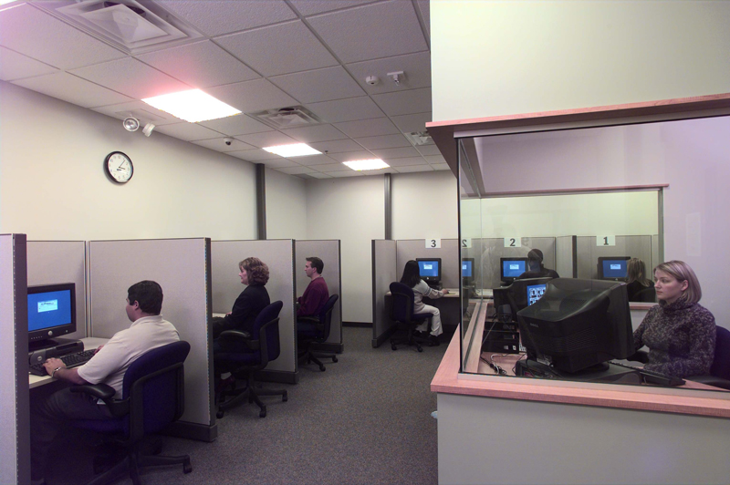

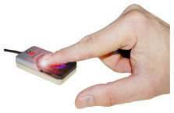

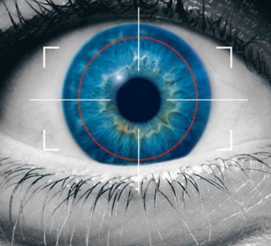
New methods to limit cheating/catch cheaters
Written “Oath”
Remotely proctored testing stations
Biometric identification checks
  Retina scans
  Typing forensics
  Finger print scans

Slide 14
New methods to limit cheating/catch cheaters cont.
Statistical analyses
  Person-fit tests
  Item time analyses
  Collussion
Follow-up tests
  CAT
  Candidate response consistency

Slide 15

Follow-up/Confirmation testing
What is a confirmation test?
  A confirmation test is a short computerized test given under supervision to verify the result obtained in an online test

Slide 16
How does ACE Confirm work?
Find the level of the candidate
Select items at a distance below their level, and see if they can answer them
Assess their progress after each item
If they are going to pass anyway stop the test early
This method is currently the most effective confirmation method
  ¼ length of traditional method (random)
  ½ length of CAT method
Makransky and Glas (2010)
High score
ACE score
Confirm items
Low score

Slide 17


Preview of ACE Confirm
Max number of items: 5-8 (depending on ACE test)
Stops test after as few as: 3 items
Average test length 7 minutes (max 15)
Three possible results
  UIT test result confirmed:
  New test recommended:
  UIT test result rejected:

Slide 18
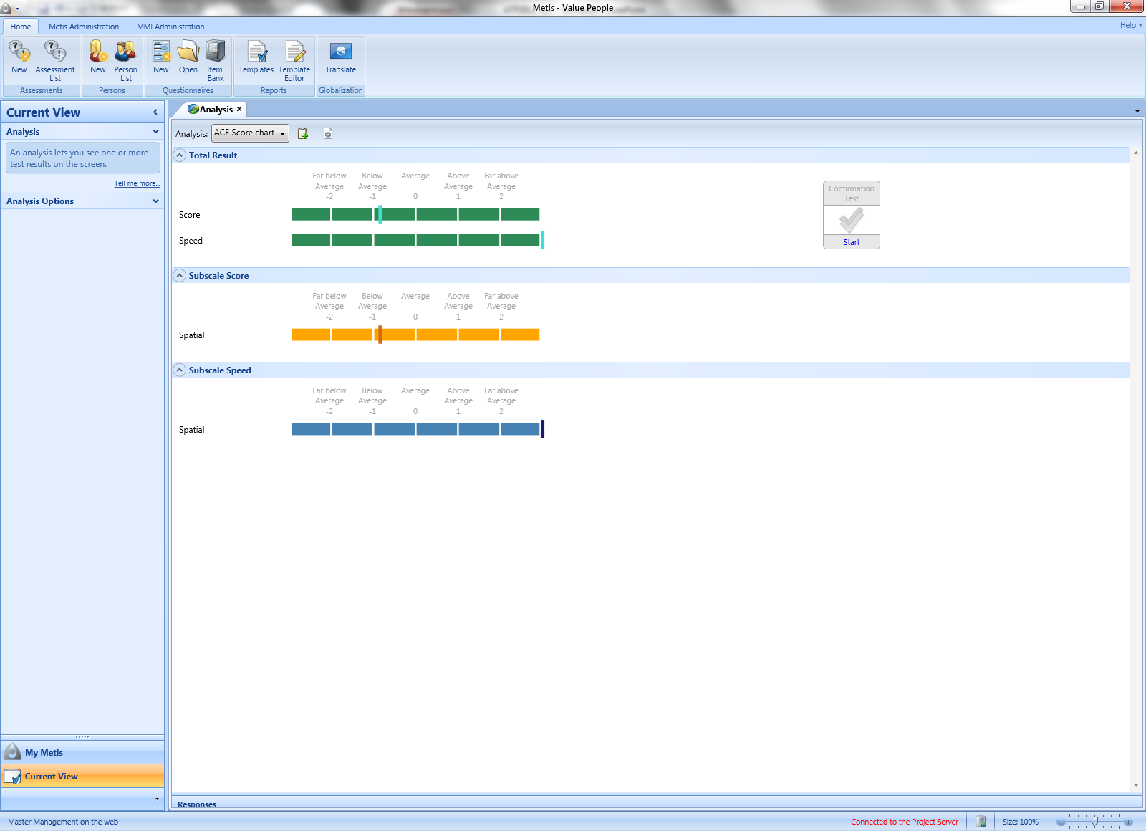

Slide 19
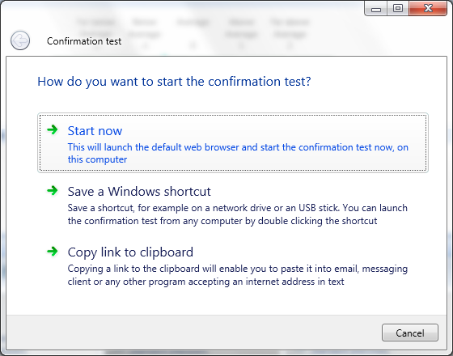

Slide 20
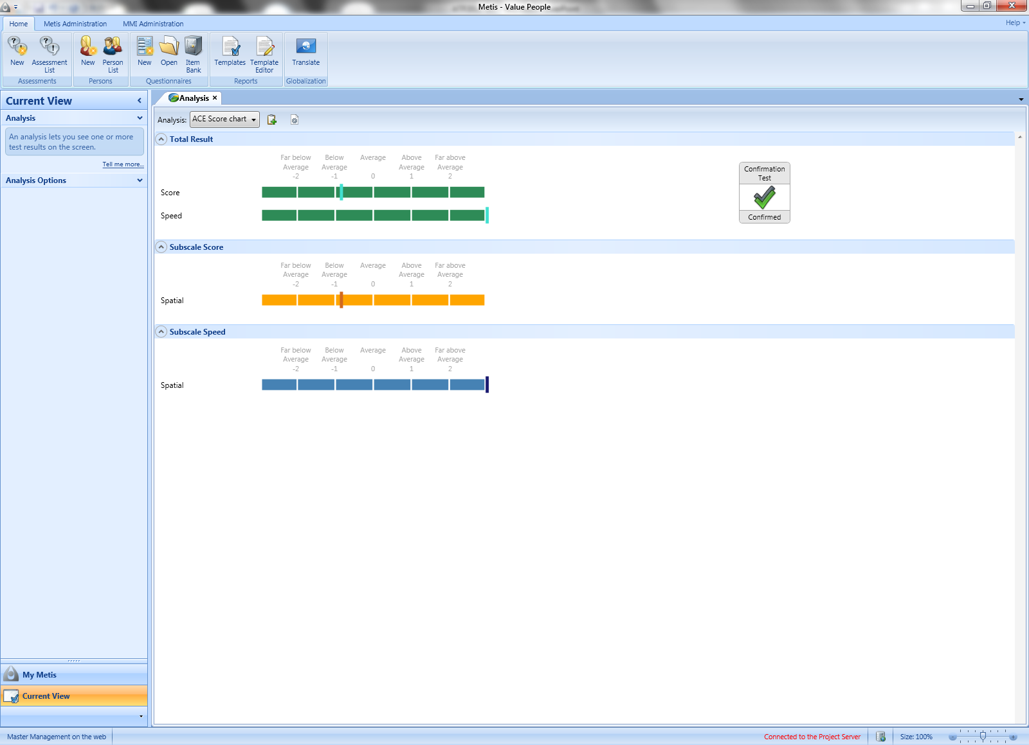

Slide 21
Results
If we have 1000 job candidates and 100 of them cheated (cheating effect = 2 sd units).
Result | Honest Respondents | Cheaters
 | 855 | 5
 | 45 | 50
 | 0 | 45

Slide 22
  Candidate response consistency
There is consistency if we administer the same items 2 times (Becker and Makransky, 2011).
  When a respondent makes a correct response to an item at time 1 they are more likely to answer that item correct at time 2
  We can correctly identify if the test taker is the same person 66% of the time using a person fit LM test (Glas and Dagahoy, 2006)
  If the first response is wrong does the probability of making the same mistake increase? Yes 72% of wrong responses at time 1 made same mistake at time 2
  Need to combine results of correct and incorrect consistency
 | < 20 common items | 20 to 30 common items | > 30 common items
ACCURACY | 65 % | 72 % | 84 %

Slide 23


Discussion
We do not expect for cheating to be as high northern Europe
But we should be prepared
Limit peoples belief in their ability to cheat
Research shows that the more you do to stop cheating the less people cheat
  Because it makes it clear that it is wrong
  Because people are afraid of being caught
Who would you rather hire a dishonest employee or an incompetent employee?

Slide 24
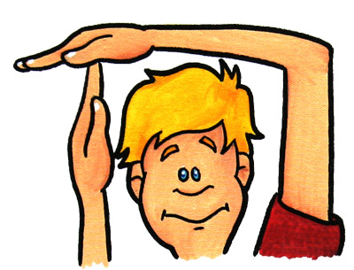
Break?

Slide 25
Faking on self report measures of typical behavior
What is faking/impression management?
How widespread is faking?
Is it a problem?
A theory of self presentation
Methods used to limit faking/self presentation
Research results related to these methods
Discussion

Slide 26
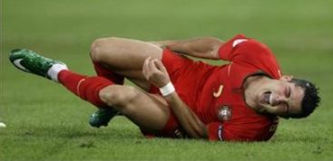
What is faking and why is it important?
Faking is probably the biggest apprehension employers have about using personality tests during the hiring process!
Faking - impression management - self presentation - social desirable responding
Faking: Intentional deceptive presentation of attributes applicants do not truly believe they possess (Lavashina & Campion, 2006)
Self presentation: attempts to adapt one’s projected self-image to situational demands of attracting prospective employers (Marcus, 2009)

Slide 27
Do test takers fake?
People are able to fake in experimental settings when they are asked to do so (e.g., Viswesvaran & Ones, 1999; Martin, Bowen & Hunt, 2002)
Job applicants score significantly higher than non-applicants on desirable personality properties (Birkeland et al., 2006)
Bigger effects in some jobs (e.g. sales)
Faking on personality measures is not a significant problem in real world selection settings (Hogan et al. 2007)
  To successfully fake means knowing what the ideal answer would be

Slide 28
Is faking a problem?
In terms of validity faking is not much of a concern in personality and integrity testing for personnel selection (Ones and Viswesvaran, 1998)
  Because faking/self presentation behavior is also related to job performance

Slide 29
Some correlates to faking
Job and test knowledge
Openness to ideas
Emotional intelligence
Intelligence
Motivation for the job
Self-monitoring behavior
Trait impression management

Slide 30

Theory of self presentation (Marcus, 2009)
Self presentation should be analyzed from the applicants perspective
Applicant must persuade the company to enter into a relationship
  Similar to starting a new relationship
  Attempt to control impressions on partners in social interactions
  Self presentation does not imply any evaluative assumptions about ethical legitimacy
Notes:
When two parties consider entering a long term relationship they must decide if they are interested in starting that relationship and also must decide if the other person is worth starting a relationship with.

Slide 31
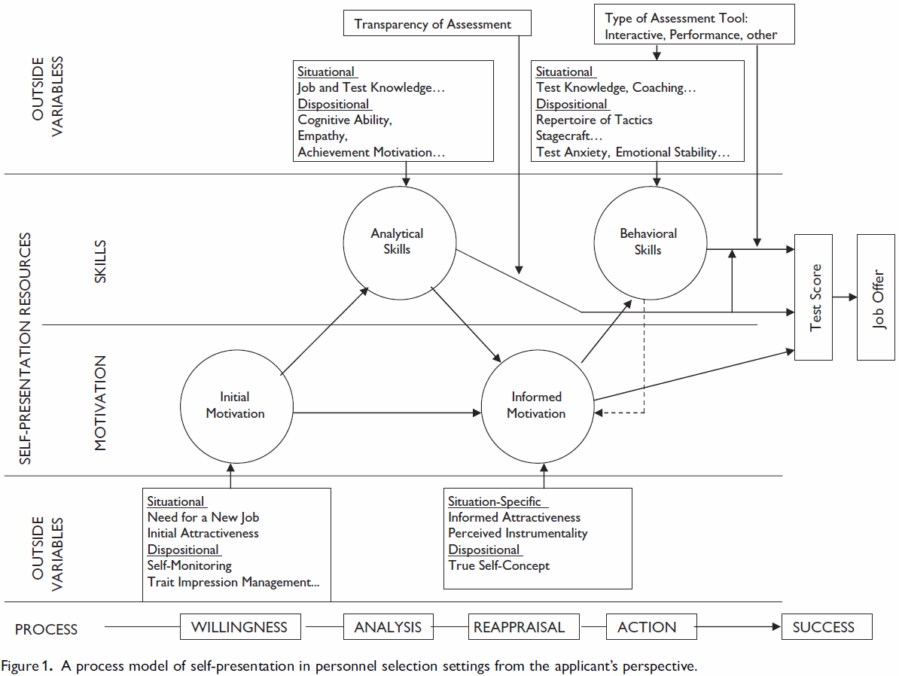
Marcus (2009) model

Slide 32
Methods to limit self-presentation
Warnings
Test design
  Ipsative /forced choice tests
  No correct answers
  Situational judgment tests
Lie/social desirability scales
Follow-up interviews

Slide 33

Warnings
E.g. test methods exist for detecting faking
  Detection will result in negative consequences for the respondent (e.g., not being considered for the job)
E.g. if you respond honestly, it is more likely that you will be placed in a job that suits you well
Warnings affect an applicant’s motivation to fake
Results:
  Warnings appear to have positive consequences when using personality tests (e.g. Mc Farland, 2003)
  Warnings in reality are less salient than in experimental conditions
  Should consider wording the warnings in a positive way since negatively worded warnings may cause test-taker anxiety

Slide 34
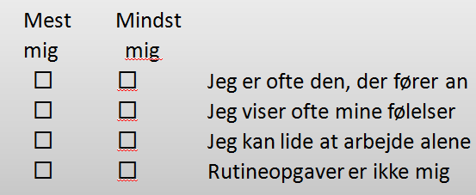
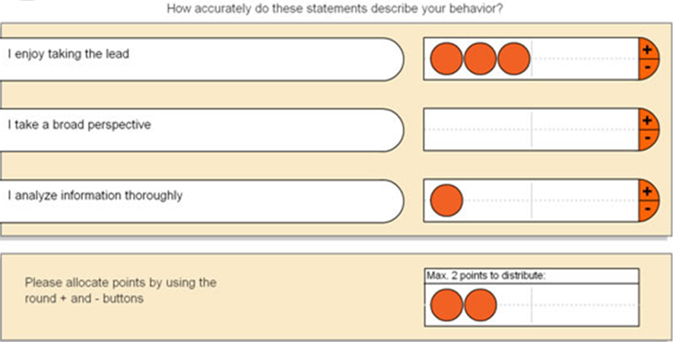
Forced choice tests
Normative vs. forced choice (ipsative, quasi-ipsative)
Normative: present one item at a time
Forced choice: respondent must prioritize among different items
If you are given the choice among several items with similar social desirability then you will likely be honest because:
  It is difficult to see what the best response would be
  Forced choice methods reduce an applicant’s ability to misrepresent him or herself

Slide 35
Are ipsative measures more fake resistant than normative measures?
Faking effect size
  1 sd for normative .33 sd for ipsative (Jackson et al. 2000)
  Differences normative no differences ipsative (Martin et al. 2002)
  Mead (2004) no real differences in terms of fake resistance
Construct validity:
  Both types of formats were susceptible to motivation distortion in terms of construct validity, however ipsative items were less related to socially desirable responses (Christiansen et al., 2005)
Criterion validity:
  In faking condition: normative format was affected but not ipsative (Jackson et al. 2000)
  Bartram found that ipsative measure resulted in higher criterion related validity
Conclusions
  Ipsative formats far less susceptible to faking compared to normative formats
  Faking still happens but not to the same extent with ipsative formats

Slide 36
Test design
Develop tests with attractive extremes
Situational judgment tests
  Integrity tests

Slide 37
Social desirability/lie scales
Detect fakers by seeing if a respondent affirms impossible statements
E.g. "I have never been untruthful, even to save someone's feelings."
A test-taker who denies many undesirable behaviors that are extremely common will receive a high socially desirable score
What should a person answer: if they do it 90% or 99% of the time, where is the cut-off of when a person fakes?
Results:
  Zickar and Drasgow (1996) say that these approaches have had limited success, because they can result in being extremely costly or embarrassing for test administrators due the high level of false positives found
  Related to neuroticism and, to a lesser degree, to extraversion and closedness Does not make sense to correct scores based on this scale
Conclusions:
  Difficult legal and ethical situations
  How can you prove faking?

Slide 38
Follow-up interviews
In Europe most test companies require a feedback interview
Most tests in Denmark are interview tools, the results are not meant to be used alone
The interview gives:
  A chance to confirm the result
  A chance to test the hypotheses from the test
  A chance to obtain behavioral examples
Interview could limit impression management because test takers know that they must give behavioral examples
The interview may also introduce more subjectivity and gives job candidates an additional opportunity for impression management

Slide 39
Conclusion
It is true that respondents to personality tests can deliberately distort their responses, especially to certain types of questions
However, it is also true that the frequency of extreme distortions is much less than commonly believed
  Why: Because within person differences are much smaller than one thinks
Most importantly, research indicates that even when candidates distort their responses, the ability to predict meaningful work outcomes is not severely diminished
  If part of the variance in personality scores is due to faking, and these do not decrease validity, from a measurement perspective it is interesting to separate these constructs so we understand the relationships better

Slide 40

Discussion
Contact info: Guidomakransky@gmail.com

