Slide 1
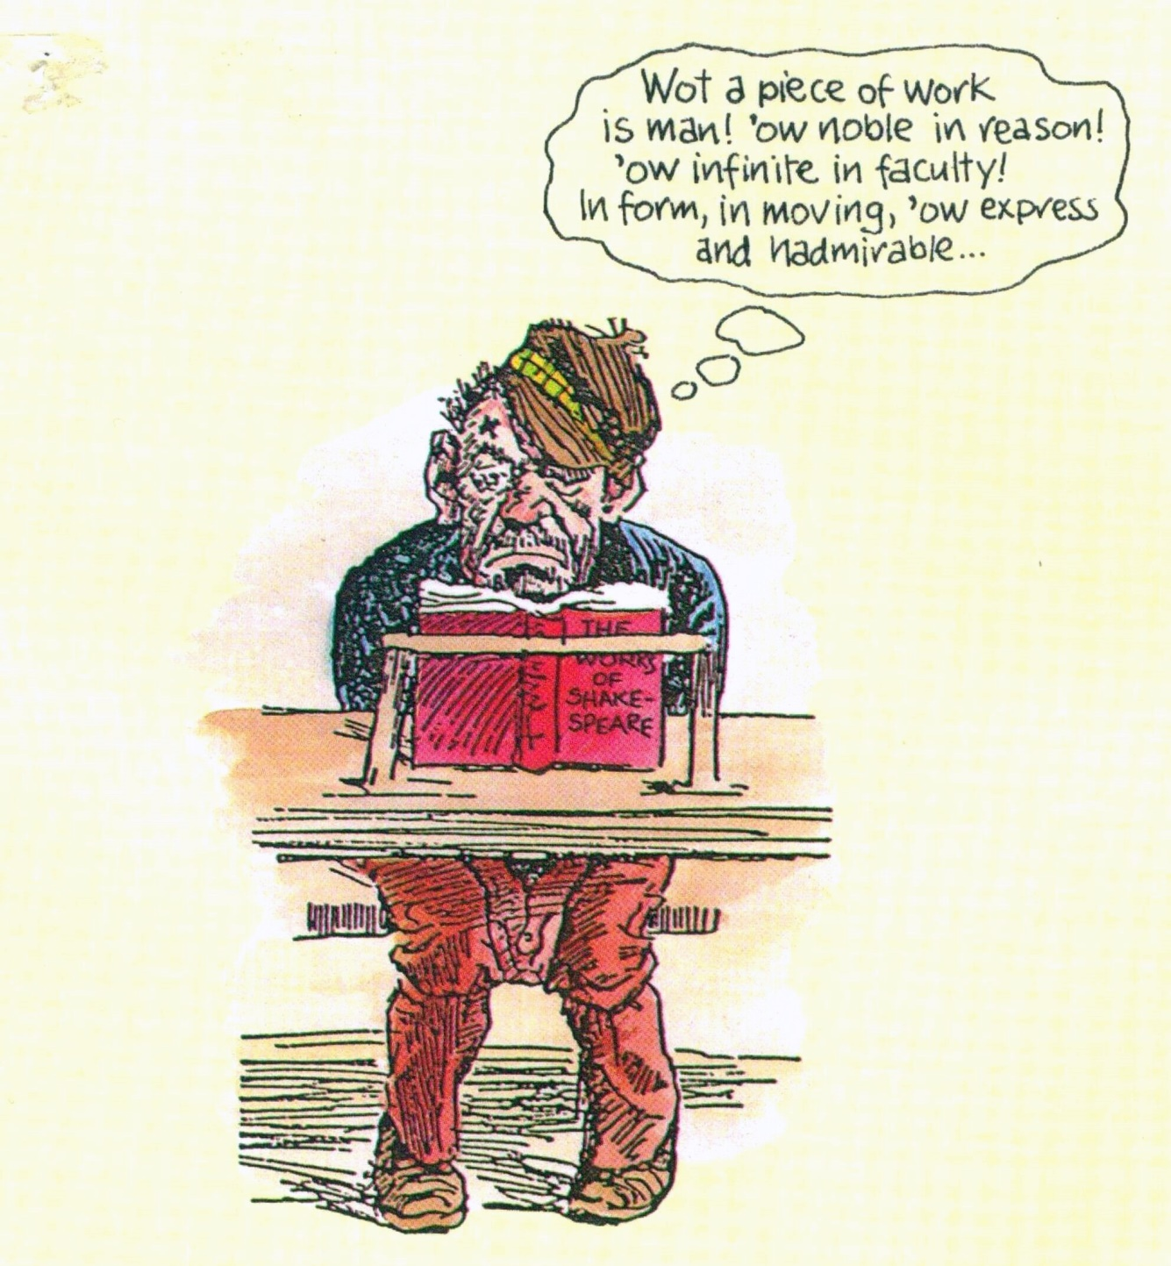

Slide 2
“Swiss Army Knife” and/or “General Purpose Computer”? WHAT A PIECE OF WORK IS MAN! Evolution & Human Cognitive Ability PSF, Danish Psychological Association April 4, 2022 © 2022 Nikolaj Lunøe • chartered psychologist. • Overgaden neden Vandet 5 B • DK 1414 København K • Danmark • +45 4046 1221 • nikolaj@capability.dk
CAPABILITY
Enabling good work

Slide 3
OVERVIEW
Summary
“Massive modularity” and beyond
Varieties of causation & explanation
(particularly “proximate” versus “ultimate”)

Slide 4
OVERVIEW
Part I: The “history” species
& its 16 billion cortical neurons
Chimps & humans: Similarities & differences
Human history proceeds at different paces in different areas ― and there is a biological, evolutionary reason why!
Why only us? “Proximate” explanations

Slide 5
OVERVIEW
Part II: Psychometrics-based speculations
on our 69+ differentiated abilities
The “positive manifold”
Shortcomings & limitations of psychometric research
A proximate explanation of the positive manifold

Slide 6
OVERVIEW
Part III: Intricacies
from evolutionary biology
Selection patterns, cost/benefit ratios of properties ― and other ultimate drivers of within-species & between-species differences
Hunter-gatherer Einsteins?! The evolutionary enigma of human cognitive capability

Slide 7
OVERVIEW
Geoffrey Miller’s year 2000 digression: Some human cognitive abilities must be the result of a sexual selection
Coda: The “ultimate” mechanism that drove the cognitive evolution of the Genus homo

Slide 8
1 SUMMARY
CAPABILITY
Enabling good work

Slide 9
TWO QUESTIONS (1)
I have two questions:
The first has to do with between-species differences,
the other with within-species differences (among ourselves: the human beings).

Slide 10
TWO QUESTIONS (2)
My first question is: Why are we, the humans, smarter than the other great apes (the chimpanzees, gorillas, and orangutans, &c)?
My second question is: Why is it that, statistically speaking, the strengths of those human abilities that are at all differentiated (i.e., can have different strengths in different people), are positively correlated (meaning that they “tend to go together”)?

Slide 11
“PROXIMATE” & “ULTIMATE” ANSWERS
Both questions have “proximate” as well as “ultimate” answers.
Proximate phenomena (or causes) are things that we can observe in organisms (bodies) here and now ― such as processes in the brain, or properties of cells or genomes.
Ultimate phenomena (or causes) are those series of events which, in a more or less distant past, somehow formed the aforementioned properties of species.

Slide 12
PROXIMATE ANSWER TO FIRST QUESTION
The proximate answer to my first question is that: we have more neurons in our brain modules (or circuits) than, say, the chimps.
That may sound self-evident or trite, but other “candidates” (such as number of synapses) were for many decades considered serious rivals,
and the fact of the matter was only finally established after the turn of the millennium (by Brazilian neuroscientist Suzana Herculano-Houzel).

Slide 13
“UNGLEICHZEITIGKEIT” IN THE BRAIN?
If we compare our own brain with that of other great apes, however, it is the cortex,
not the subcortical areas or the cerebellum,
that has added more neurons.
One might argue that this has created a kind of “Ungleichzeitigkeit” between different parts of our brains, minds, and behaviors.

Slide 14
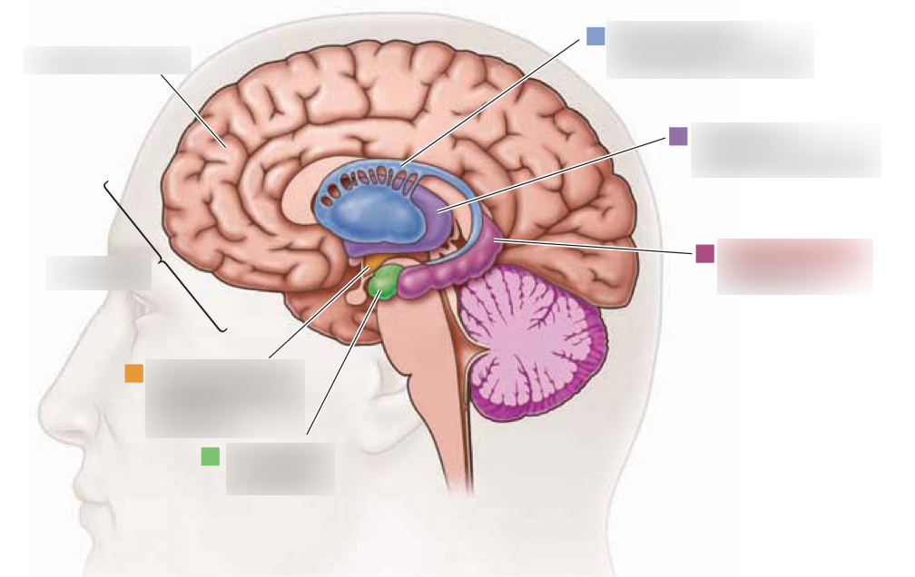

Slide 15
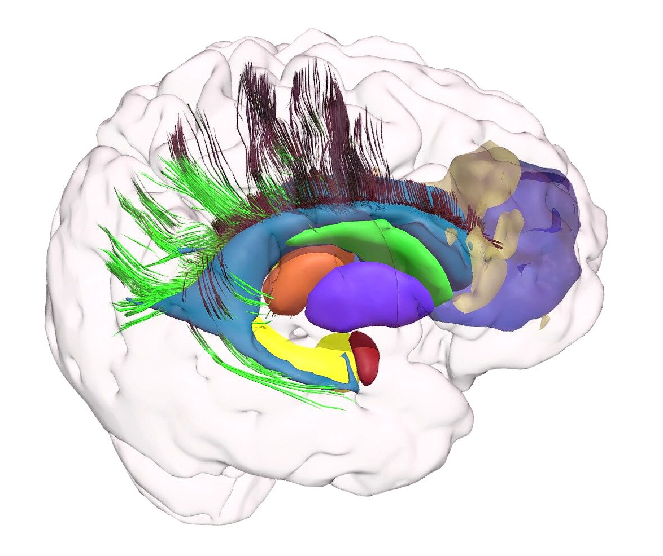

Slide 16
SWITCHES & SUPER-SWITCHES
Most genes are elements that can go into recipes for the cell’s synthesis of different “household” or “special” proteins.
Some genes, however, are used by the cell for deciding when to switch the synthesis of a particular protein on or off at specific moments
― and still others, called “super-switches,” may turn on or off a combination of several such switches at the same time.

Slide 17
QUANTIFIER GENES & SIZES OF ORGANS, ORGANISMS & BEHAVIOR
Such information gives us a feel for why, ultimately, some genes appear to act as quantifiers for properties or behaviors of organisms ―
which is why organisms, organs, and behaviors that, qualitatively speaking, are very similar
come in surprisingly different sizes and magnitudes (such as sub-species & “races”).

Slide 18
GENES & ACUITY
The presence of genetic quantifiers almost certainly explain why
some species have more neurons in similar brain modules than other species, and thus also more “acuity” ―
and they may, perhaps, also explain why there can be within-species differences for the same thing.

Slide 19
PROXIMATE ANSWER TO SECOND QUESTION (1)
Now, ability differences between individuals make themselves felt as cost/benefit ratios for, among other things,
acquiring new knowledge (or new skills)
applying such knowledge successfully to problem-solving and decision-making, plus
creating new knowledge (or new skills) …

Slide 20
PROXIMATE ANSWER TO SECOND QUESTION (2)
… and the reason why, statistically speaking, people who can learn, for example, to understand and “handle” other people’s emotions with less effort than can most of us,
tend to be able to also, for example, learn German grammar with less effort,
must be that:

Slide 21
PROXIMATE ANSWER TO SECOND QUESTION (3)
those of us who have more neurons in one brain circuit (which may be devoted to, say, perceiving and “coding” other people’s emotions)
also do tend, statistically speaking,
to have more neurons in all other brain modules (e.g., in those specializing in German grammar).

Slide 22
THE JURY IS STILL OUT, THOUGH
Again, that may sound terribly self-evident or banal, but I believe “the jury is still out on this one”: there is not yet any consensus, and
rival candidates for an explanation ―
such as a “domain-general” (as opposed to “domain-specific”) brain module ―
are probably still being considered in some quarters.

Slide 23
NO GPU IN THE BRAIN
There is, however, no evidence of such a “general purpose processing module” in the brain ―
even though it may appear so to the mind (as I shall try to explain)!

Slide 24
g IS A FACTOR, NOT A MODULE
There are general concepts (e.g., “das Seiende” = that which exists) and schemes in our minds and thinking, and
in statistical factor analysis there is a g factor,
but there is no g module in the brain.

Slide 25
“HYPOTACTIC” COORDINATION ≠ GPU
There certainly is an “executive” module: the pre-frontal area
(which adds “hierarchical” or “hypotactic” coordination
to the “paratactic” ditto
of more “domain-specific” modules) ―
but that is a very different thing (from a GPU)!!

Slide 26
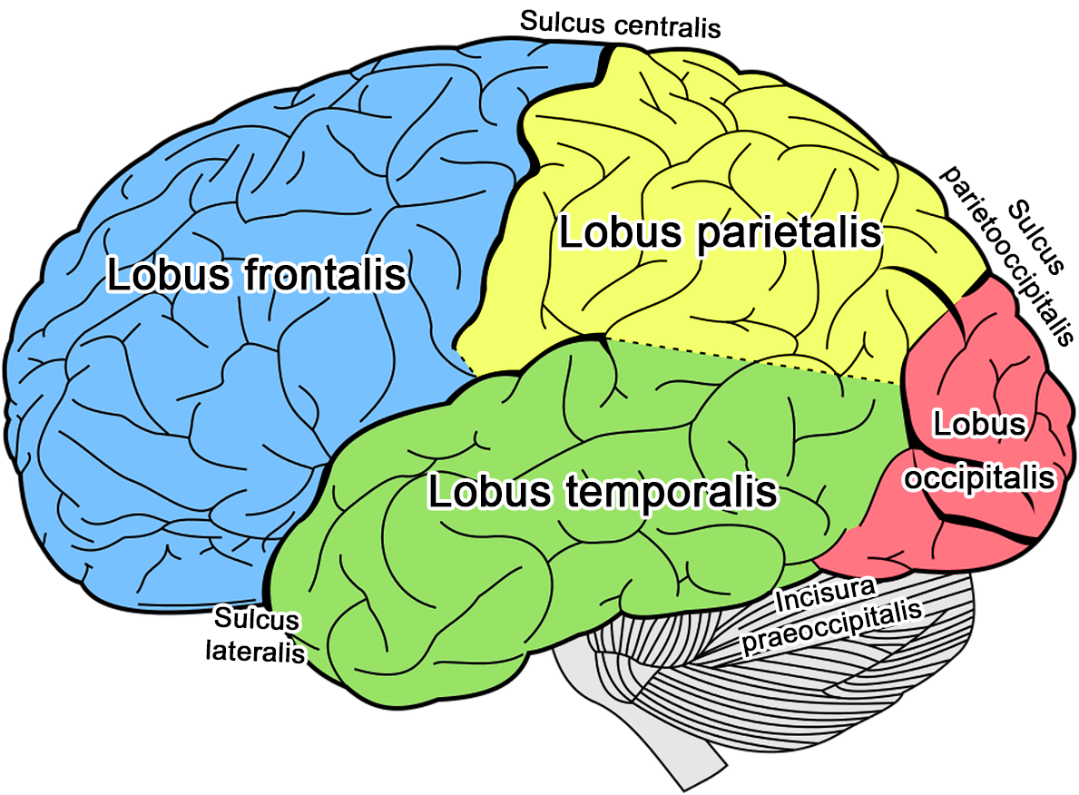

Slide 27
ULTIMATE ANSWER TO FIRST QUESTION (1)
The ultimate answer to the first question was finally found in 2009, when British-American primatologist Richard Wrangham suggested
a peculiar natural selection mechanism which
must have driven the gradual “transition” from early member species of the Genus homo (such as Homo ergaster) into its later ditto (such as us).

Slide 28
ULTIMATE ANSWER TO FIRST QUESTION (2)
Wrangham’s explanation quickly became widely accepted.
I will try to summarize it below, of course ― but, to keep a bit of “suspense,” not until my “coda.”
☺

Slide 29
ULTIMATE ANSWER TO SECOND QUESTION?
My own modest proposition is that
Wrangham’s ultimate answer to the first question (“why are we smarter than the chimps?”)
should offer us a key to the ultimate answer to the second question (“why are the strengths of differentiated human abilities positively correlated?”).
I will discuss this at some length below.

Slide 30
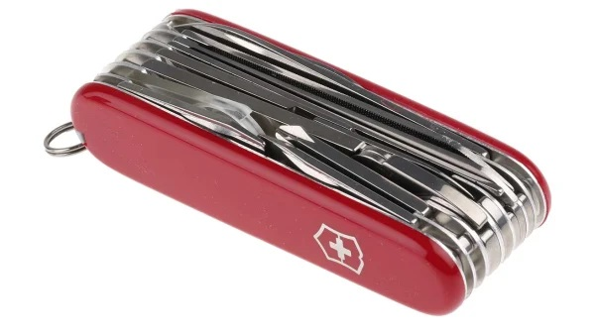

Slide 31
2 MASSIVE MODULARITY & BEYOND ― plus a few words about this presentation
CAPABILITY
Enabling good work

Slide 32
MY POINT OF DEPARTURE
“The idea that central cognitive processes may be ‘massively modular,’ and that this modularity is underpinned by evolutionary forces, has become increasingly influential in the past 15 years.”
― Nick Chater, University College London, 2007

Slide 33
MASSIVE MODULARITY IS A FACT (1)
The bare word “modular” does not necessarily imply a connotation of “extreme domain-specificity” …

Slide 34
MASSIVE MODULARITY IS A FACT (2)
… and, like I said, we do know of at least one brain area (the prefrontal cortex) which appears to contain
modules that work in a fashion similar to what social science has dubbed a “second order specialist”
= someone whose work consists of coordinating what other (“first-order”) specialists are doing (in DK: a “djøf’er”).

Slide 35
HJERNENS DJØF’er? ☺

Slide 36
MOST MODULES ARE DOMAIN-SPECIFIC (1)
As the their name suggests, domain-specific modules process information pertaining to particular aspects or areas of reality
e.g., sight, smell, predators, food opportunities, mating opportunities, social deceit, offspring in need ―
and probably tens of thousands
of other things …

Slide 37
MOST MODULES ARE DOMAIN-SPECIFIC (2)
… and there can neither be any doubt that the brains and minds of most animals (including us) basically do consist of a very large number of such highly domain-specific modules …

Slide 38
MOST MODULES ARE “ANSWERS” TO SPECIFIC ASPECTS OF ENVIRONMENTS
… nor that these have all evolved as specific biological “responses” or “answers” to specific aspects of those environments in which they (and we) have lived.
In evolutionary biology, such environmental aspects are sometimes also referred to as “selection pressures” (a topic I will discuss in some detail below).

Slide 40
THE “SWISS ARMY KNIFE” HYPOTHESIS
This is what is also known as the “Swiss Army Knife” hypothesis about the structure of human cognition:
Such a device may have a large and small blade, a can-opener, a corkscrew, a pair of scissors, a nail file, and so on.

Slide 41
TOOLS & ABILITIES MAY WORK AS “EXAPTATIONS”
Each of these devices may certainly be used for purposes other than those the people who designed them had in mind ―
as if they were “exaptations,” to borrow a term from evolutionary biology ―
and the same obviously may be true of separate, “domain-specific” human abilities.

Slide 42
NO “GENERAL PURPOSE TOOL”
There is, however, no “general purpose tool” on a Swiss Army Knife ―
and no “general purpose processing unit” in the human brain.

Slide 43
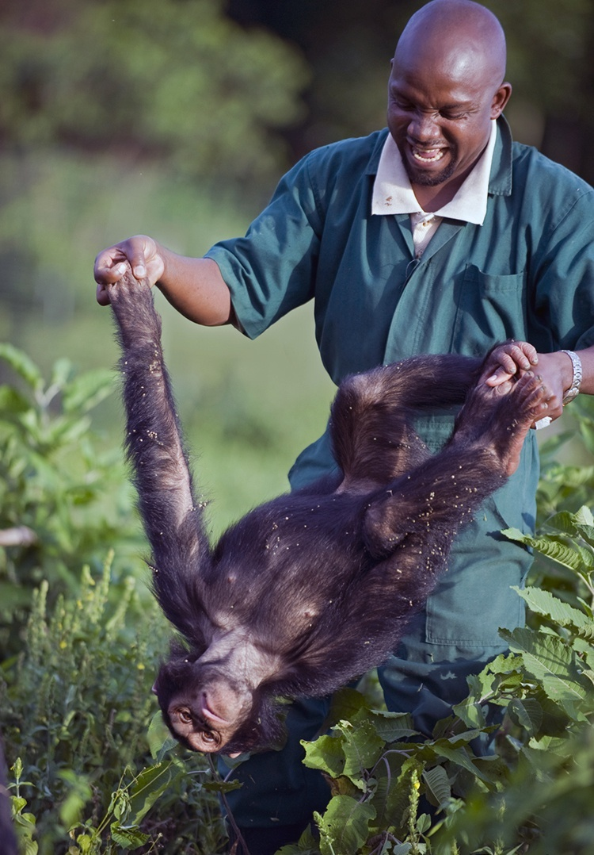

Slide 44
MY PROBLEM
One problem remains, though:
If we compare our own (human) mind & brain to those of close cousins, such as the chimpanzees,
we can only point to a few new, “added” abilities and modules that appear to perhaps be exclusively our own:
In terms of mind & behavior, the most striking is: A “discursive” language.
In terms of brain modules, the most striking are: Wernicke’s and Broca’s areas.

Slide 45
THE DIFFERENCE BETWEEN CHIMP & HUMAN BRAINS IS NOT ONE OF “ADDED MODULES” …
In other words, the most salient cognitive difference between our species and that of the chimps
is one of quantity, not quality!
It is not at all that we have added many more modules, but rather that:

Slide 46
… THE DIFFERENCE IS ONE OF NEURONS ADDED TO MODULES
abilities, which we clearly share with chimps, are much more powerful in us ― and that
brain modules, most of which we also share with chimps (and which, qualitatively speaking, are almost entirely identical)
contain many more neurons in our version than they do in theirs.

Slide 47
MY QUESTION
So the ultimate question must be this:
What sort of environmental aspect or “selection pressure” could possibly explain this difference (of added neurons, not modules)?
☺ ☹

Slide 48
CRITERIA A CANDIDATE MUST MEET
I will spend most of the time available trying to describe this question’s context, plus some of
the interlacing criteria or demands that a candidate answer (or candidate answers) must meet ―
and consider this the most important part of my presentation.

Slide 49
WHY NOT MAKE IT SHORT & SWEET?
I could probably summarize the (proximate & ultimate) answers to both of my two initial questions in ten or twenty minutes.
So: do I have a reason for having prepared three hundred PP slides (other than the desire to hear myself talk)?
Allow me to remind you of the “Zeigarnik Effect” (even though I know its validity is disputed)!
☺

Slide 50
SOMETIMES APPRECIATION REQUIRES KNOWLEDGE (1)
My argument is this:
The 2009 book offered a simple, elegant solution to a true enigma
which had haunted psychology and biology for decades ―

Slide 51
SOMETIMES APPRECIATION REQUIRES KNOWLEDGE (2)
… and without some understanding of why this problem had been so enigmatic ―
i.e., of the wickerwork of contradictory, interacting mechanisms or “laws” of evolution that somehow had blinded us until then
― we will hardly appreciate just how formidable the 2009 solution actually was.

Slide 52
ENTHYMEME
In rhetoric, the word enthymeme [ἐνθύμημα]
refers to a serial argument which tacitly omits one or several steps or links ―
because “if one of these is known [by the audience],” wrote Aristotle, “it does not have to be stated, since the hearer supplies it.”

Slide 53
CAVE: AN “ENTHYMEMATIC” PRESENTATION (1)
Now, the following presentation attempts to bring together observations, concepts, and models from two rather different professional or intellectual domains:
Evolutionary biology and
psychometrics-based psychology.

Slide 54
CAVE: AN “ENTHYMEMATIC” PRESENTATION (2)
I would like to think that, when taken together, these elements can shed a light on each other
and merit a conclusion.
But since I must omit a number of aspects (which I myself find relevant and indeed interesting),
I fear my presentation may come across as somewhat inconsecutive or “enthymematic.”
☹

Slide 55
3 VARIETIES OF CAUSATION & EXPLANATION
CAPABILITY
Enabling good work

Slide 56
THREE KINDS OF KNOWLEDGE
For a start, let me remind you that the late Danish philosopher David Favrholdt (1931-2012) was fond of distinguishing what he called three “kinds” of knowledge:
Knowing that,
knowing how ― and
knowing why.

Slide 57
CAUSAL EXPLANATION
We would not want to be without any of them, but: the latter ― i.e., causal explanation ―
is particularly crucial to the endeavor we have dubbed “science.”

Slide 58
SIX VARIANTS OF EXPLANATION
Another Danish philosopher, Jan Faye (b. 1947), has listed six variants of explanation:
Causal
(or perhaps I should say: “causal proper”),
nominal,
functionalistic,
functional,
intentional, and
interpretative

Slide 59
WHAT IS “UNDERSTANDING” MADE OF?
… all of which I think should be highly relevant to the purposes of this learned society ☺ ―
as is, I believe, Faye’s crucial overall question: how can we at all define what it means to “understand” something?

Slide 60
COMPONENTS, MECHANISMS, GENESIS (1)
Today, however, I will limit myself to mentioning that causal explanation proper comes in at least three variants:
Components: We may (in a “reductionist” fashion) ask what a phenomenon is made of ― ignoring, as it were, time.

Slide 61
COMPONENTS, MECHANISMS, GENESIS (2)
Mechanisms: We may ask how these components interact ― “in order to” produce the phenomenon we have observed.
Genesis: We may ask how these components were first “brought together,” i.e., how the observed phenomenon was generated ―
thereby clearly applying a temporal perspective.

Slide 62
CHINESE BOXES
Of course, outside the realm of elementary particle physics, reductionist “component causation” is a “Chinese Box” phenomenon:
For example, organisms are made of organs, organs are made of cells, cells are made of membranes + cytoplasm + organelles, and so on and so forth
― and at some point we just have to stop.

Slide 63
PROXIMATE & ULTIMATE CAUSATION
However, evolutionary biology also systematically applies two variants of causal explanation:
Proximate causes ― and
ultimate causes.

Slide 64
PROXIMATE & ULTIMATE CAUSATION
These are somewhat pretentious (albeit highly useful) names for
causes that are active and can be observed here-and-now
(such as a genetic recipe that every cell in our body will apply several times a day) and the
causes which shaped those mechanisms in the first place in the (sometimes distant) past.
I will discuss an example in “chapter” 9 of this presentation.

Slide 65
QUESTIONS & (SOME) ANSWERS
Below, I will declare information according to Faurholdt’s three categories of knowledge, and then
ask about proximate and ultimate causes (for human cognitive ability),
as well as about the components, mechanisms, and genesis of living entities in general ―
and try to answer some (but certainly not all) of them.

Slide 66
TERMINOLOGY
Throughout this presentation the word behavior will refer to anything a living entity
(such as a cell, an organ, or an organism)
does ―
including, for example, silent human thought and thinking.

Slide 67
Part I THE “HISTORY” SPECIES ― and its 16 billion cortical neurons
CAPABILITY
Enabling good work

Slide 68
4 CHIMPS & HUMANS Similarities & differences
CAPABILITY
Enabling good work

Slide 69
CHIMPANZEE CULTURAL DIFFERENCES (1)
In nature and human social organization alike, many boundaries are “fuzzy.”
For example, primatologists have listed several differences between cultural practices of various chimpanzee communities
that appear quite similar to the kind of differences we can observe among diverging cultures created by our own species.

Slide 70
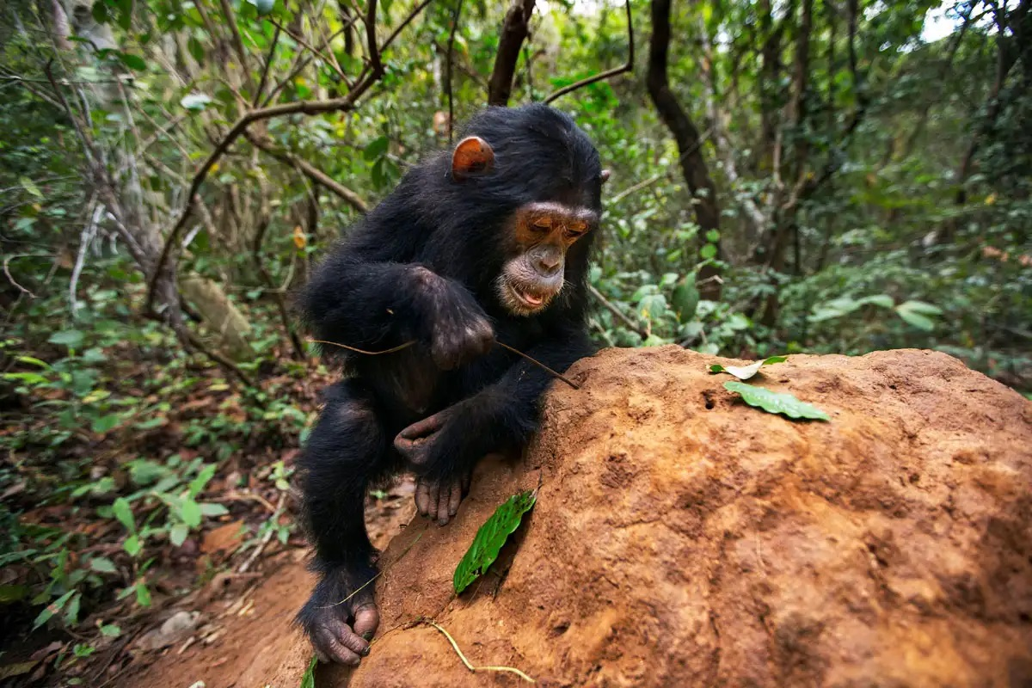

Slide 71
CHIMPANZEE CULTURAL DIFFERENCES (1): TOOLS
Here are three examples:
Some chimpanzee groups use sticks, while others prefer sponges (made from chewed leaves) when extracting honey from the log hives of bees,

Slide 72
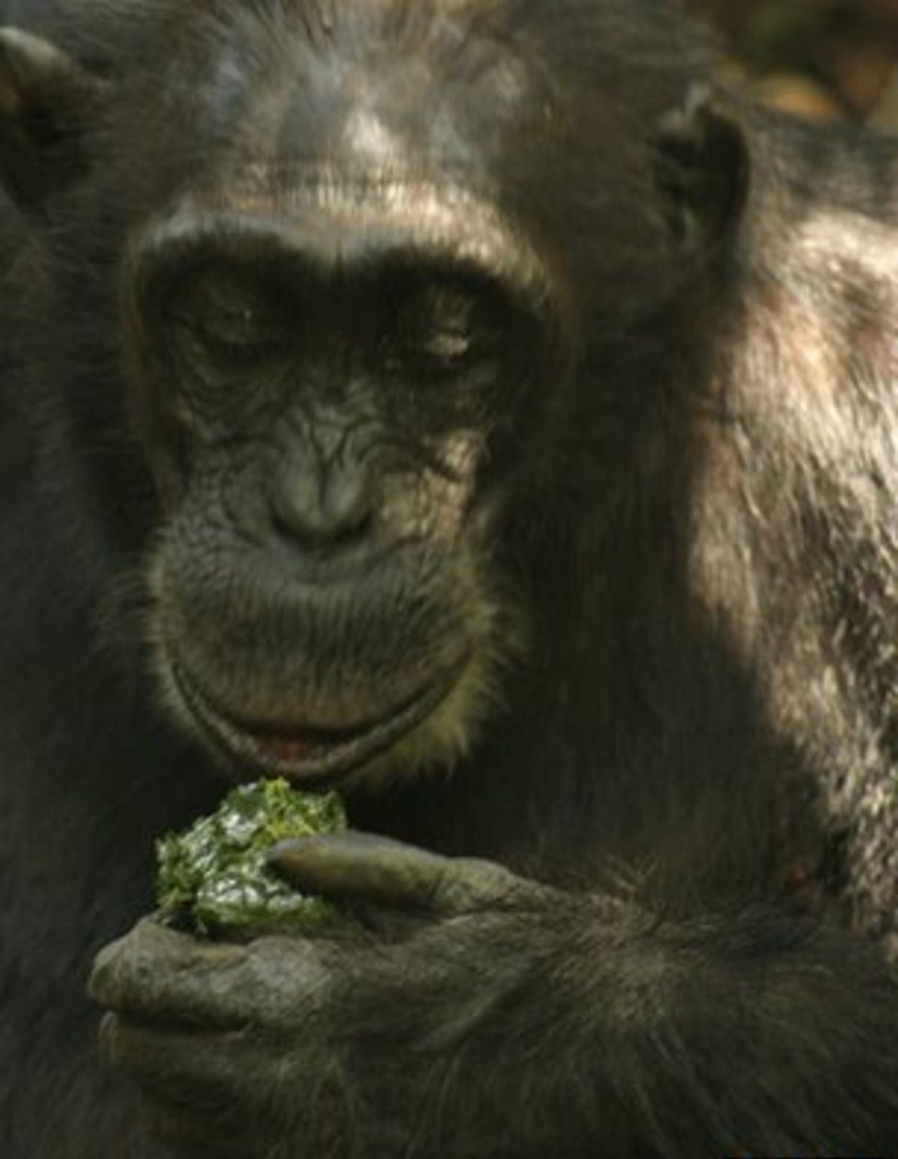

Slide 73
CHIMPANZEE CULTURAL DIFFERENCES (2): MISS MANNERS
the manners and customs that appear to be considered socially appropriate, e.g. during grooming, can also be quite different,

Slide 74
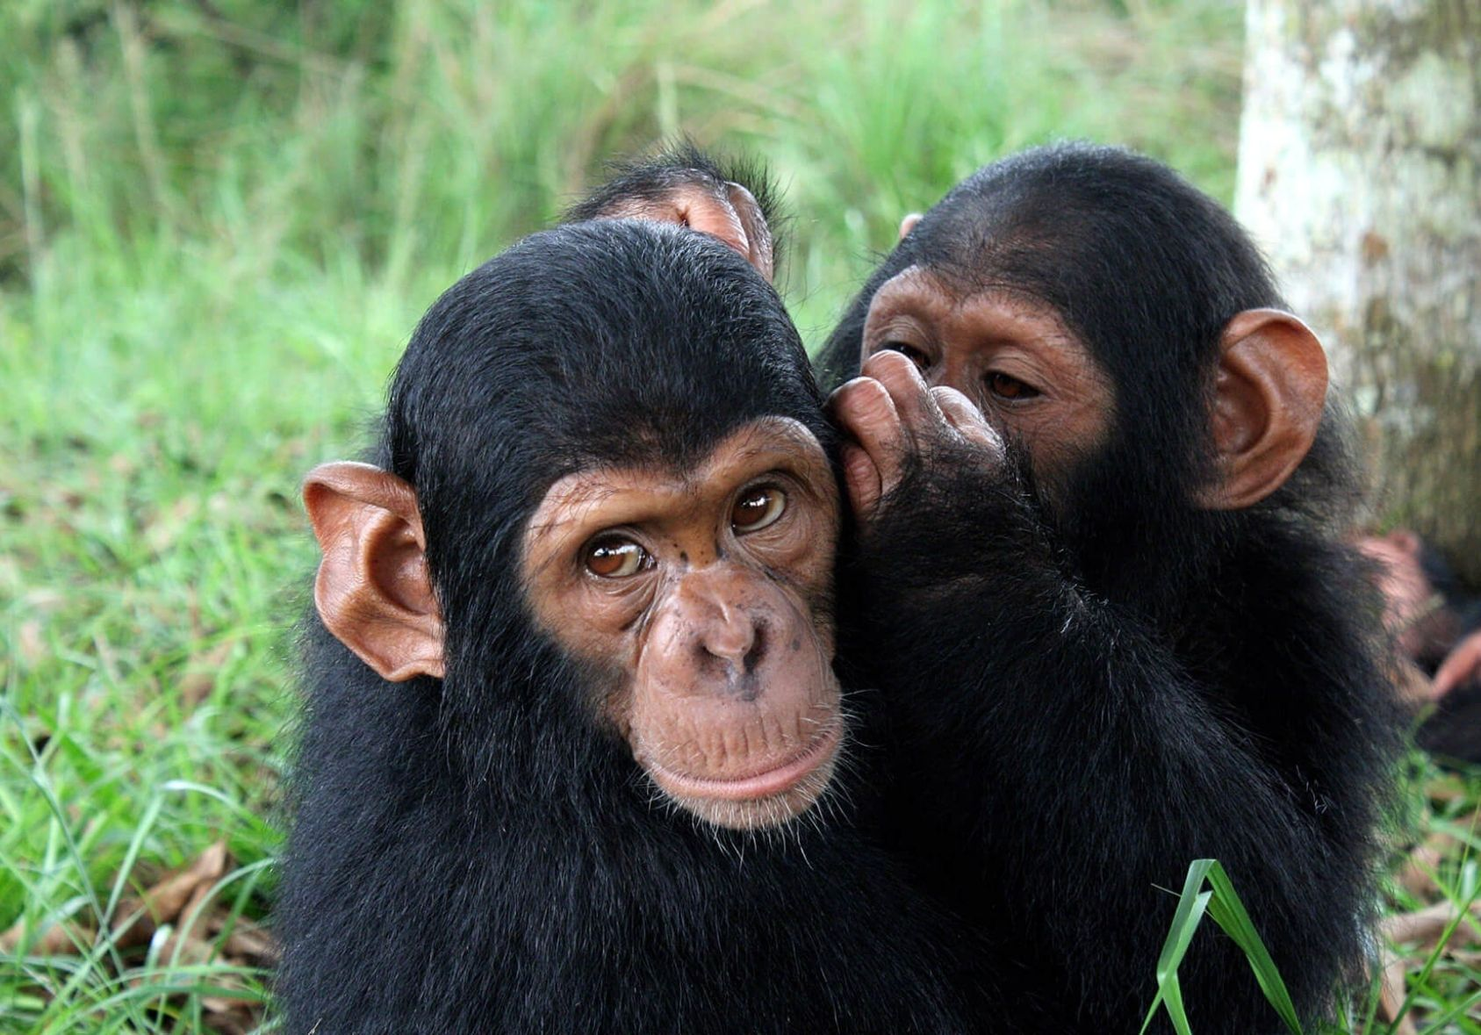

Slide 75
CHIMPANZEE CULTURAL DIFFERENCES (3): DIALECTS
… and
different groups speak distinctly different dialects when pant-hooding (= long-distance vocalizations used for expressing excitement, e.g., when finding rich fruit trees, or greeting other members of the community, or staying in touch during travel).

Slide 76
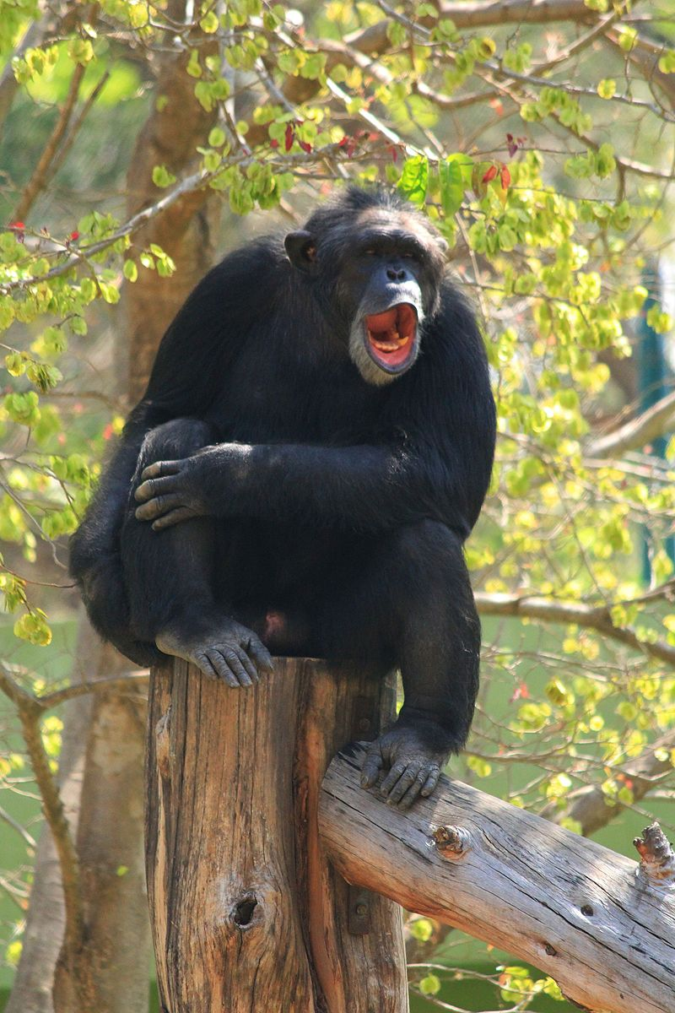

Slide 77
NURTURE, NOT NATURE
None of these practices are “hardwired.” They are the results of a communal historical development ― results which, in turn,
young individuals acquire by means of a social learning process as they grow.

Slide 78
THE DIFFERENTIAL Ψ OF CHIMPS & HUMANS (1)
What is true of between-group cultural differences,
no doubt also is true for within-group individual differences between single individuals ―
some of which, however, certainly are “hardwired” (rather than acquired):
Chimpanzees (like dogs) do indeed have different personalities.

Slide 79
THE DIFFERENTIAL Ψ OF CHIMPS & HUMANS (2)
But imagine gathering the 100 most diverse chimpanzees from all of Africa
plus the 100 most diverse human beings from the same continent.
Generally speaking, I would expect to find much more divergence in the human sample.

Slide 80
THE DIFFERENTIAL Ψ OF CHIMPS & HUMANS (3)
This difference, however, would be most pronounced in the area of knowledge, skill, and cognitive ability ―
and much less so in the area of spontaneous emotional reaction patterns (≈ temperament).

Slide 81
“NEUROTICISM”
From
ROBUST
THICK-SKINNED
To
SENSITIVE
THIN-SKINNED

Slide 82
CHIMPS: PAST = PRESENT
So: chimps do have “acquired” collective, cultural differentiation ― and individual personality ditto.
But to my knowledge, no evidence suggests that chimpanzees of today live a life essentially different
from the one their ancestors enjoyed, say, 500 or 10,000 years ago.

Slide 83
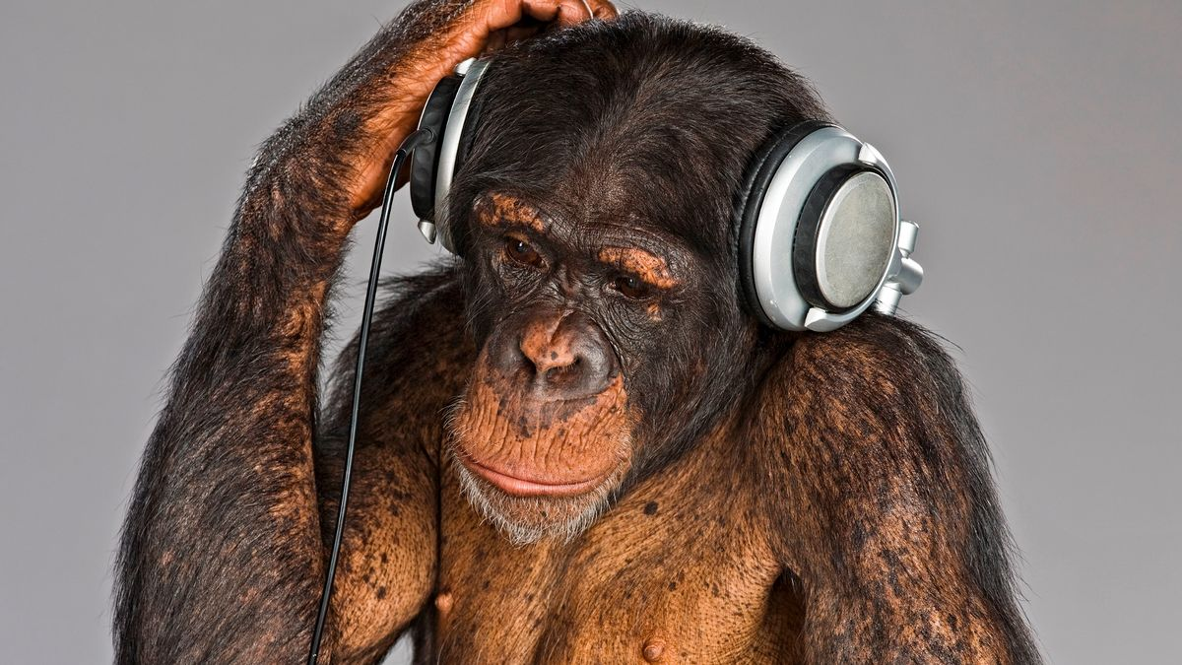

Slide 84
THE “HISTORY” SPECIES
So in spite of the similarities outlined above, I consider it safe to say that Homo sapiens remains the only species that has a
(technological, economic, cultural, social and, last but not least, military)
history proper.

Slide 85
HISTORY & LIFE ON THE DANISH ISLES
For example, there can be no denial that, generally speaking,
everyday human life on the Danish isles today
is vastly different from what it was, say, 5,000 years ago ―
during the late Neolithic period [bondestenalderen].

Slide 86
BEFORE THE YAMNAY INVASION: STONE TOOLS

Slide 87
AFTER THE (2nd) YAMNAY INVASION: BRONZE TOOLS

Slide 88
IRON TOOLS

Slide 89
5 HUMAN HISTORY PROCEEDS AT DIFFERENT PACES IN DIFFERENT AREAS ― and there is a biological, evolutionary reason why!
CAPABILITY
Enabling good work

Slide 90
UNEQUAL HISTORICAL DEVELOPMENT IN HUMAN AFFAIRS
I allow myself to add, though, that human history does appear to progress at very different paces,
not just in different geographical parts of the world, but also
(and more importantly, I would argue)
in different domains of “human affairs.”

Slide 91
THE FAST LANE (1)
Vehicles speeding up in “fast lane” of human history include our understanding of the natural sciences:
physics,
astronomy,
chemistry,
geology,
biochemistry, and
biology ―

Slide 92
THE FAST LANE (2)
… as well as their “applied” cousins in
technology.

Slide 93
ACCELERATING TECHNOLOGIES (1)
To illustrate: In 1984 the late German philosopher Odo Marquard wrote that:
“Wo vor 2000 Jahren ein Wald war und
vor 1000 Jahren ein Feld und
vor 500 Jahren ein Haus,
stand vor 150 Jahren ein Weberei,
vor 75 ein Bahnhof,
vor 25 ein Flugplatz …

Slide 94
ACCELERATING TECHNOLOGIES (2)
… und steht heute ein Weltraumsatellitenterminal ―
und was dort in 10 Jahren stehen wird:
das wissen wir noch nicht.”
He concluded that
(contrary to what some 18th century philosophers had complained about in their day) …

Slide 95
“FORCES” versus “RELATIONS” OF PRODUCTION?
… no “relations of production” [produktionsforhold]
(such as pre-revolutionary feudal guilds, or the absolutist state)
appear to be at all holding back the free development of the “forces of production” [produktivkræfterne] any more.

Slide 96
… AND “ACCELERATION SOCIETY”
On the contrary, we seem to live amidst an unstoppable, permanent technological revolution ―
and Marquard dubbed the result of this (new?) state of affairs: the “acceleration society”
[das Beschleunigungsgesellschaft].

Slide 97
THE SLOW LANE (1)
But I, for one, doubt that, for instance,
the way we human beings experience and express emotion in everyday life, or
the essential joys and sorrows inherent in love relations among adults
have developed as dramatically since Antiquity as have our physics- and chemistry-based technologies …

Slide 98
THE SLOW LANE (2)
… and offer, as an example, Aristotle’s book on Rhetoric:
We can apply all of his basic concepts, his entire theory, and all of his practical advice “as is” today, without any difficulty
when working out speeches or lectures.

Slide 99
Aristotle [Ἀριστοτέλης], 384–322 BC

Slide 100
THE SLOW LANE (3)
Because, unlike much in Aristotle’s teachings on, e.g., physics or biology,
nothing in his work on Rhetoric (or in that of Cicero, 106-43 BC) has become obsolete ― and
despite countless volumes of elaborations and reflections added during the era of Scholasticism and beyond …

Slide 101
THE SLOW LANE (4)
… the discipline can hardly claim to have made progress in a way that would merit a comparison with the development of, say, physics, chemistry, or biology ―
and I, for one, do not expect that to ever happen.
☹

Slide 102
ANSWER TO MARX?
I would like to think that this simple, non-controversial assumption
(about an unequal pace of historical development in different realms of human affairs)
also suggests an answer to a question posed by Karl Marx (in Grundrisse, 1857-58, Introduction, Part 4):

Slide 103
“SUB SPECIE AETERNITATIS”
“The difficulty lies not in understanding that the Greek arts and epic are bound up with certain forms of social development.
The difficulty is that they still afford us artistic pleasure and that in a certain respect they count as a norm and as an unattainable model.”

Slide 104
FROM KNOWING “THAT” TO KNOWING “WHY”
Fans of Faurholdt may notice, just in the bypassing,
that Marx knew that Aeschylus [Αἰσχύλος] and Euripides [Εὐριπίδης] and other playwrights
still “afforded him artistic pleasure” ―
but he also wanted to know why?
☺

Slide 105
BRAIN-BASED ROOTS OF UNEQUAL HISTORICAL DEVELOPMENT?
Finally, I would argue that this “strongly unequal historical development” (or pace) in different domains of human life
must be rooted in
differing properties of the different parts of the human brain that each produce them.

Slide 106
EVOLUTION EXPLAINS PACE OF HUMAN HISTORY
This is tantamount to saying that
there is an biological, evolutionary (i.e., “ultimate”) explanation
why different areas of human history proceeds at very different paces!

Slide 107
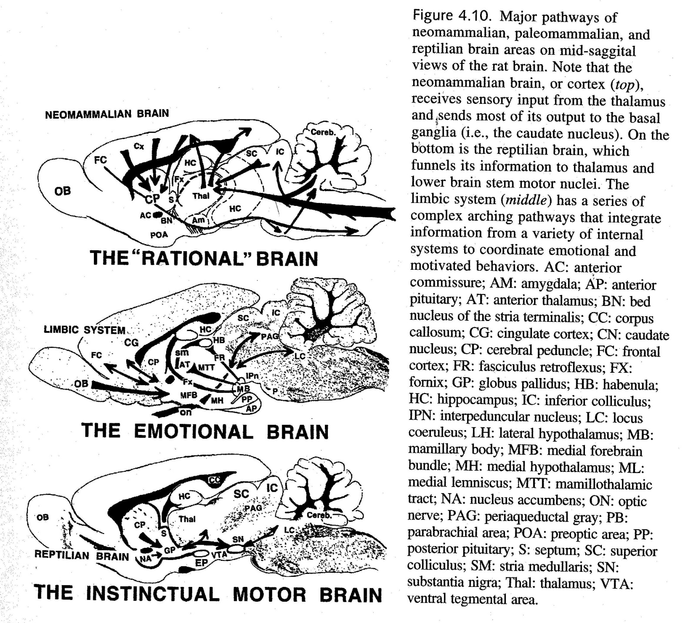

Slide 108
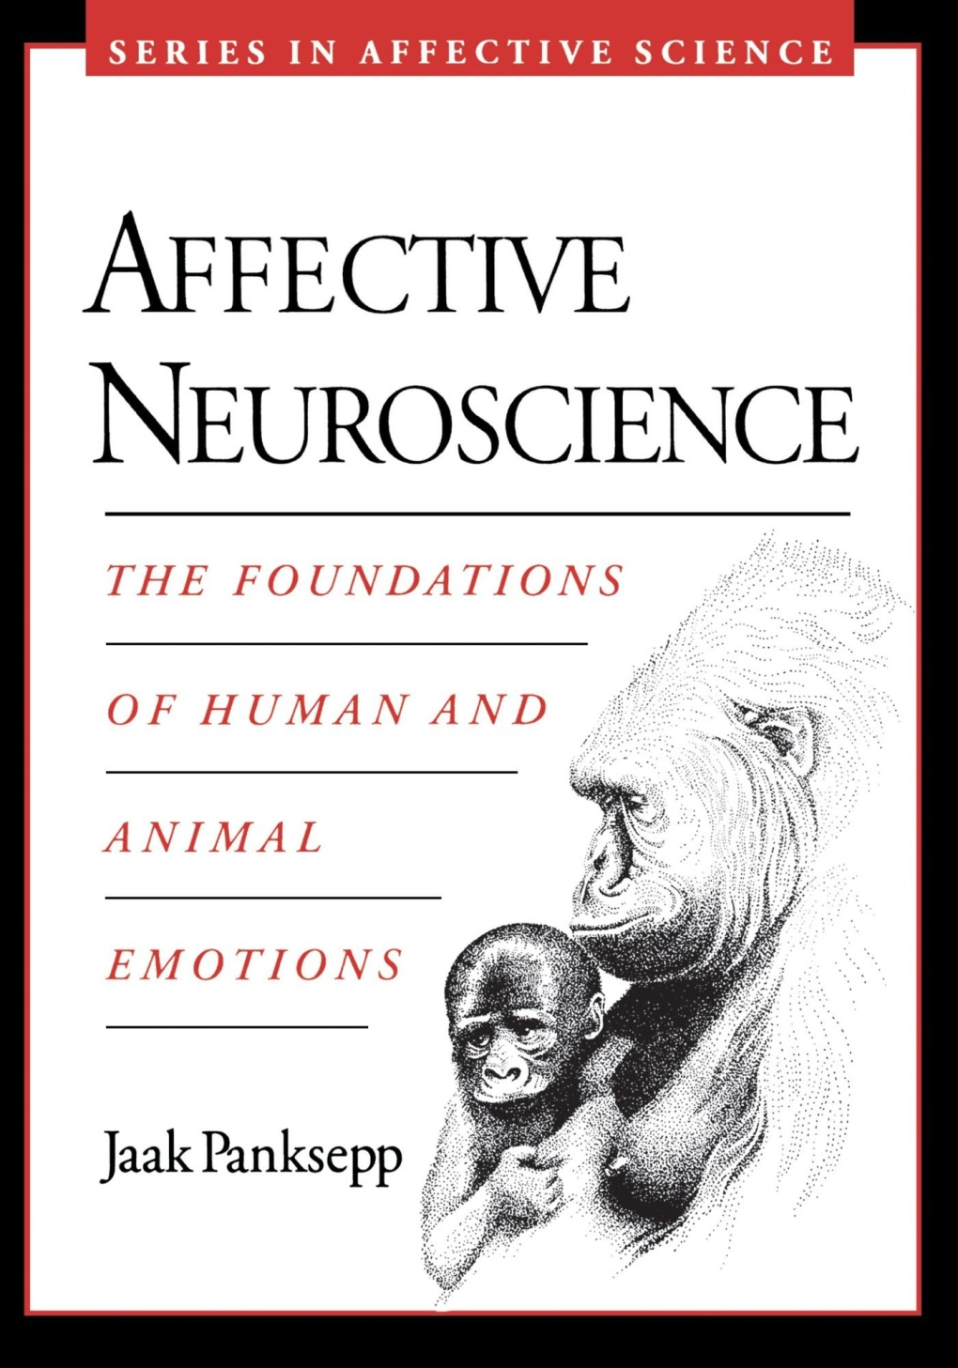

Slide 109
IMMENSE CORTICAL VARIATION
The cortical circuits that produce intellectual behavior proper, contain innumerous neurons.
Due to their sheer number, they are capable of learning (and inventing) all sorts completely “new stuff” from scratch,
and their activity can be controlled by a built-in volition (adding a strong sense of agency to our inner experience).

Slide 110
LIMITED SUB-CORTICAL VARIATION (1)
Emotional behavior, on the other hand, emerge largely from sub-cortical neural circuits which, by comparison, are quite tiny.
Their learning capacity is restricted to something akin to habituation and sensitization …

Slide 111
LIMITED SUB-CORTICAL VARIATION (2)
… and they are, as everyone knows from personal experience,
essentially involuntary or automatic phenomena.

Slide 112
OUR OWN BEHAVIOR: PREDICTABLE & UNPREDICTABLE (1)
In other words, cortical “cognitive” or “intellectual” circuits are capable of producing an immense variation in behavior
(including immense variation in intense, but silent thought) ―
and as a result, we can never predict the actual content of our own future intellectual development (nor that of others, for that matter).

Slide 113
OUR OWN BEHAVIOR: PREDICTABLE & UNPREDICTABLE (2)
By comparison many grown-ups,
having had some past experience with our own involuntary emotional reactions,
may be able to predict our future emotional reactions (to different types of situations) fairly well.
(Sadly, though, that may not necessarily imply that we can manage them any better.)
☺

Slide 114
AN OBSERVATION FROM PSYCHOMETRIC TESTING (1)
Or, to apply a more external view:
Let us assume that we have learned from the results of a person’s answers to a psychometric “personality” (I would prefer to say: “temperament”) test that she harbors a strong tendency to blow her top.
Once the latter actually happens, we will then probably be less surprised (albeit perhaps not any less scared) that it does ―

Slide 115
AN OBSERVATION FROM PSYCHOMETRIC TESTING (2)
… and most likely we will also not be surprised by the kinds of actual acts she performs while in the grips of her temper tantrum ― such as:
Shouting, cursing, hammering a hand in the tabletop, breaking things, punching others on the nose, &c.

Slide 116
AN OBSERVATION FROM PSYCHOMETRIC TESTING (3)
Now, for comparison, let us imagine that a person’s answers to a psychometric ability (or intelligence) test have suggested that
she is extremely gifted in some area of mathematics (say, “algebraic topology” ― though I haven’t the faintest idea what that is).
Then we may not be greatly surprised if one day we learn that she has been awarded the Abel Prize (a Nobel cousin of sorts).

Slide 117
AN OBSERVATION FROM PSYCHOMETRIC TESTING (4)
But would our (or better: another mathematician’s) knowledge of her test result have enabled us (or rather: her math colleague)
to predict the actual content of the entirely new mathematical discovery (or proof) that she has made, and which merited this prestigious award?
Clearly not!

Slide 118
THE “TRIUNE BRAIN”: MacLEAN’s ANTHROPOLOGY (1)
This difference (and many others) between similar pairs of “meta-properties” of different brain circuits
was of course the main, built-in point of Paul D. MacLean’s famous “triune brain” model:
An original attempt at creating a neuroscience-based “anthropology,” I would argue ―

Slide 119
THE “TRIUNE BRAIN” MODEL

Slide 120
THE “TRIUNE BRAIN”: MacLEAN’s ANTHROPOLOGY (2)
... which has fallen out of fashion with our colleagues from neuropsychology ―
probably because they feel that it is of little help for conducting research projects on the workings of highly domain-specific neural circuits.
Even Suzana Herculano-Houzel, whose work I shall introduce shortly, doesn’t like it either.
☹

Slide 121
PAUL D. MacLEAN (1913-2007)

Slide 122
PHYLOGENETIC ALLUVIAL (1)
But: from one perspective, the human mind and brain is a conglomerate “alluvial,” as it were, of different “sediments”
which epochal “waves” of the evolution of the species have left in us
because they at one time proved beneficial to our survival
(and, nota bene, have continued to do so) ―

Slide 123
PHYLOGENETIC ALLUVIAL (2)
… and I believe that MacLean was basically right when he said that sequences of
our evolutionary past are primarily reflected in the “bottom-up” arrangement of circuits (producing qualitatively different behaviors)
along the vertical axis of our brains.

Slide 124
6 WHY ONLY US? Proximate causes
CAPABILITY
Enabling good work

Slide 125
HISTORICAL DEVELOPMENT: WHY ONLY US?
So: Why do we have a history?
(Or rather: Why do we have a history?)

Slide 126
THE PROXIMATE CAUSE
In the case of human cognitive capability, there has long been consensus that the proximate cause must be that
our brains are somehow more capable than those of other species ― though
exactly how has been a matter of some debate.

Slide 127
OUR 86 BILLION BRAIN NEURONS: SHE COUNTED THEM! (1)
The issue was only settled after the turn of the millennium,
when Brazilian neuroscientist Suzana Herculano-Houzel (b. 1972)
developed a method for actually counting the number of neurons in the human brain.

Slide 128
OUR 86 BILLION BRAIN NEURONS: SHE COUNTED THEM! (2)
Until she did that, we only had estimates ―
which turned out to over-estimates
(as was also the case with estimated number of single genes in the human genome before the HUGO project was completed in 2003).

Slide 129
SUZANA HERCULANO-HOUZEL (b. 1972)

Slide 130
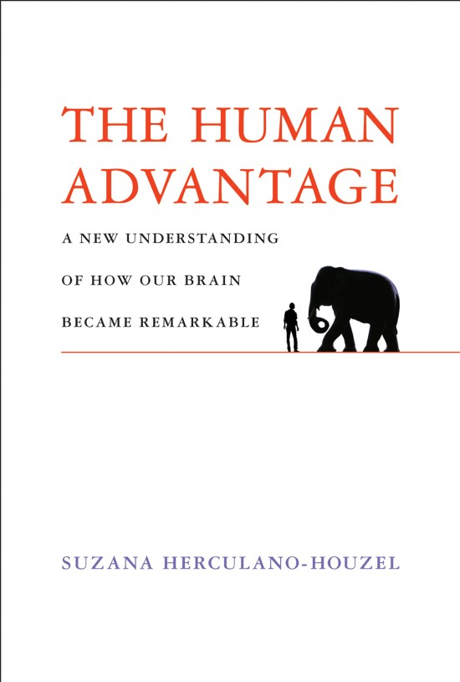

Slide 131
16 BILLION NEURONS IN THE HUMAN NEOCORTEX
The human brain, it turned out, contains a total of 86 billion neurons ―
glia (astrocytes, oligodendrocytes, and microglia) not included.
Of these,
59 billion are located in the hippocampus, and
16 billion in the neocortex …

Slide 132
IN TERMS OF NUMBER OF NEURONS SUB-CORTICAL AREAS ARE TINY
― which leaves us with a mere one billion located in sub-cortical areas
(largely = MacLean’s “limbic system”).
(Astrocytes, by the way, are assumed to be more abundant than neurons, but remain uncounted.)

Slide 133
6 BILLION NEURONS IN THE CHIMP NEOCORTEX
To my knowledge, no similar exact “census” has been conducted for the neurons in the brain of our close evolutionary cousin, the chimpanzee ―
but Herculano-Houzel’s estimate is that the chimp cortex probably contains some 6 billion neurons.

Slide 134
“MISSING LINKS” ☺
This difference between the chimps and us is quite dramatic and, needless to say,
the more so because all those other member species of the Genus homo that went before us
(and who undoubtedly also had many more neurons in their cortexes than had the chimps)
have long been extinct.

Slide 135
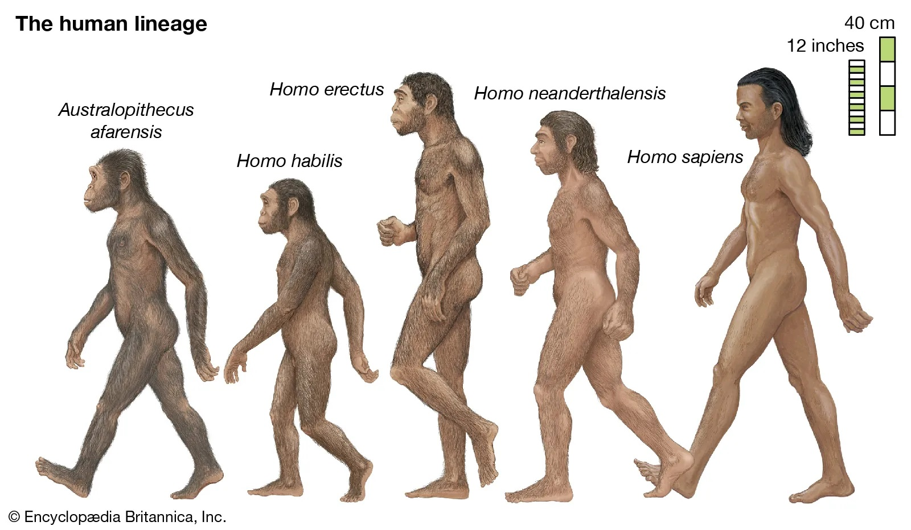

Slide 136
EXTINCT “HISTORY” SPECIES
In other words, some of the member species of Genus homo that went before us
probably were smart enough to also have gone through a historical development.
As we will see (in my coda), H. erectus and H. neanderthalensis almost certainly invented new technologies,
and a sub-species of H. habilis, named H. ergaster, probably did too.

Slide 137
WERE CHIMPS & HUMANS ALWAYS THAT FAR APART?
Yet the question remains: Were our two cousin species (chimps & humans) always that far apart
(in terms of number of neurons in the cortex part of our brains),
i.e., right from their respective very beginnings ...

Slide 138
OR IS PART OF OUR “COMPARATIVE ADVANTAGE” OF A MORE RECENT ORIGIN?
… or did we, the humans, only gradually add some significant proportion of our “10 billion comparative advantage”
during the millennia that we have walked this earth?

Slide 139
SOME SAY A HUMAN “COGNITIVE REVOLUTION” ONLY BEGAN SOME 70,000 YEARS AGO
Some believe the latter to be true, since a number of highly sophisticated “innovative” technologies,
based on materials that were always available to our ancestors ―
e.g., boats, oil lamps, bows & arrows and, last but not least, needles made of bone ―
all appear to have been introduced during a period that only began 70,000 years ago.

Slide 140
WETWARE OR MINDWARE?
That sounds probable to my ear.
Yet we cannot exclude the possibility that those innovations were the result of a (steady or abrupt) increase in accumulated “mindware” ― i.e., in knowledge and skill ―
that was obtainable on the basis of an unaltered, already-sufficient “wetware” capacity which had been present among our ancestors long before that.

Slide 141
NO RELIABLE BIOLOGICAL INFORMATION AVAILABLE
Within-species differences in size-of-skull are not a reliable indicator of number of cortical brain neurons among vertebrates, and
we cannot yet predict the latter from (live or dead) DNA differences between the genomes of humans (or other species).

Slide 142
SO WE JUST DUNNO
Consequently, we cannot yet know whether there has been a (steady or abrupt) increase in the actual “raw material” or “wetware”-based intelligence of our species
during the 200,000 (or perhaps even 300,000) years we have walked this earth?

Slide 143
Gf & Gc (1)
Borrowing a conceptual pair which rightly belongs to the next, “psychometrics”-oriented Part II of my presentation:
the measurement of “fluid abilities” (Gf) purports to represent an approximation to what we (for want of a better name) may call the “raw material” intelligence of our own (and other) species ―

Slide 144
Gf & Gc (2)
… and an increase in the average Gf score of a population over time may, at least in theory, be indicative of an improvement of brain “wetware.”
“Crystallized abilities” (Gc), on the other hand, is just a fancy name for what we in everyday parlor call “knowledge” and “skill” …

Slide 145
Gf & Gc (3)
… but at this moment in time, we cannot yet say for sure whether the “cognitive revolution”
that appears to have begun some 70,000 years ago
was caused by an increase in Gf or Gc ― or both?

Slide 146
CONTINUITY & DISCONTINUITY (1)
Science often appeals to a distinction between allegedly “continuous” and “discontinuous” phenomena.
(Textbook examples of the latter include: (mammalian) pregnancy, and “phase transitions” in physics.)
The word “event,” for example, suggests an element of discontinuity ―
and so does biology’s concept of differing “species.”

Slide 147
CONTINUITY & DISCONTINUITY (2)
The distinction certainly “makes sense,” and is probably indispensable for our ability to describe the world around us ―
yet, like many other basic concepts, it may appear less self-evident upon close inspection.

Slide 148
WHY ARE THERE SPECIES?
Since evolution is believed to largely proceed gradually or accumulatively (if not incrementally)
in a long, continuous series of “small steps,”
we may ask why we at all do see different species around us ―
and never mistake, e.g., a chimpanzee for another human?

Slide 149
ISOLATION & SPECIATION
In order to explain this, biologists have collected a rather long list of “isolating” mechanisms
that can account for speciation
(but which I will not summarize today).

Slide 150
MEMBERS OF Genus h. PROBABLY DO NOT CONSTITUTE DIFFERENT SPECIES AT ALL (1)
Suffice to say that one commonly proposed criterion is the claim that
two lineages (of multicellular, sexually reproducing individuals) descending from a common ancestor
will constitute two different species the moment their members can no longer interbreed
and produce fertile offspring.

Slide 151
MEMBERS OF Genus h. PROBABLY DO NOT CONSTITUTE DIFFERENT SPECIES AT ALL (2)
Judged by this criterion, we (H. sapiens) and our ancestors in the Genus homo ―
such as: H. habilis, H. erectus,
H. heidelbergensis, and H. neanderthalensis ―
probably were (or are) not different species at all.

Slide 152
Part II PSYCHOMETRICS-BASED SPECULATIONS on our 69+ differentiated abilities
CAPABILITY
Enabling good work

Slide 153
7 THE “POSITIVE MANIFOLD”
CAPABILITY
Enabling good work

Slide 154
WHAT PSYCHOMETRIC ANALYSIS CAN DISCOVER
Subjecting data from psychometric intelligence testing
to mathematical regression analysis (such as exploratory and confirmatory factor analysis)
can only help us discover (i.e., sort out) abilities which are differentiated (i.e., differ in strength from one person to another).

Slide 155
BUT MANY HUMAN ABILITIES ARE PROBABLY NON-DIFFERTIATED
This is worth keeping in mind, since humans (like other animals) may well possess a great many cognitive abilities which are completely non-differentiated.
I offer, as an example, Luria’s famous case story of a patient suffering from visual agnosia due to a damaged secondary, “synthesizing” area of the visual cortex:

Slide 156
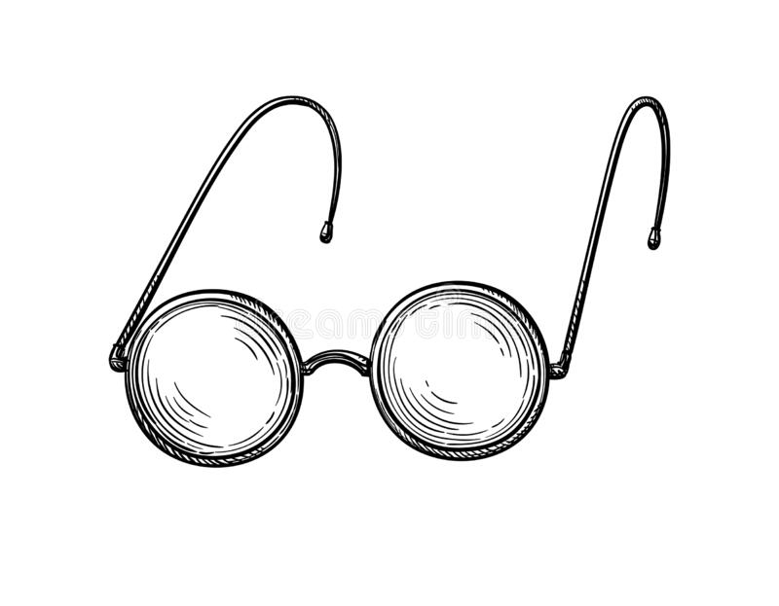

Slide 157
VISUAL AGNOSIA
When shown a picture of a pair of old-fashioned, round spectacles, the patient identified (a) two circles and (B) two walking-stick-like shaped elements ― and suggested the interpretation: “A bicycle.”
When shown a picture of a clock, the patient concluded: “A chicken hatching from an egg.”

Slide 158
“YOU NEVER MISS THE WATER TILL THE WELL RUNS DRY”
These examples may well give us a glimpse of non-differentiated abilities
of which we only become aware when they are damaged or missing.
But granted, those abilities that do differ in strength from one person to another
are usually those that are more relevant for most practical purposes.

Slide 159
INTELLIGENCE IS A MULTI-DIMENSIONAL PHENOMENON
No psychometrically oriented ψst ever claimed intelligence to be a single, unitary phenomenon!
The most comprehensive re-analysis (published by John B. Carroll in 1993) suggested that
we could, by then, distinguish 69 separate differentiated abilities.

Slide 160
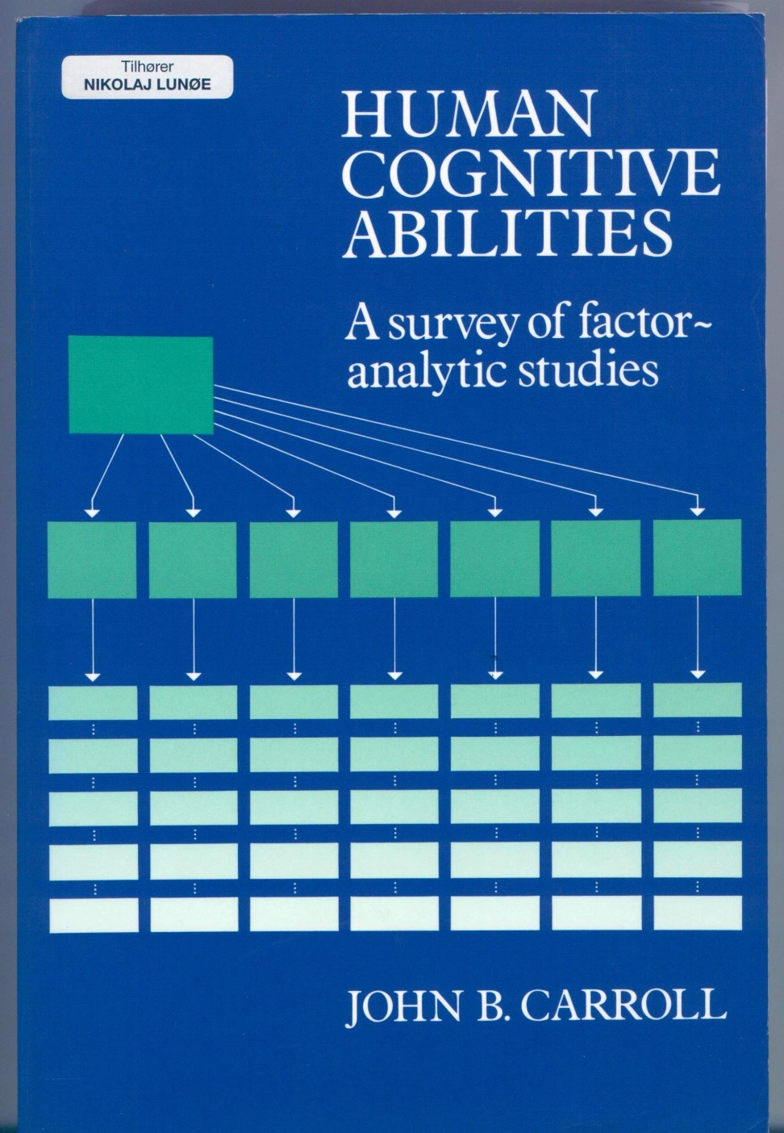

Slide 161
THE g FACTOR (1)
But Carroll’s re-analysis also confirmed, once again, what we have known since Charles Spearman (1863-1945) first published his finding in 1904:
In any population of human beings, the strengths of all known differentiated abilities are positively correlated (i.e., they tend to go together).

Slide 162
CORRELATION MATRIX FOR THE WAIS TEST

Slide 163
g LOADINGS OF WAIS-R SCALES
 |  | g
Sim | Similarities | 0.75
Voc | Vocabulary | 0.70
Inf | Information | 0.69
PC | Picture Completion | 0.68
PA | Picture Arrangement | 0.68
Com | Comprehension | 0.67
Ari | Arithmetic | 0.66
BD | Block Design | 0.57
OA | Object Assembly | 0.50
DSp | Digit Span | 0.47
DSy | Digit Symbol | 0.37

Slide 164
THE g FACTOR (2)
The Scottish ψst Ian Deary has called this the most substantiated research finding in the entire field of ψ research. In other words,
there is a shared g-factor for all differentiated cognitive abilities that we know of,
the “g-loading” of each of these tend to be quite high and, most significantly …

Slide 165
“THE LITTLE g IANT”
research into the practical utility of intelligence test results strongly suggests that, for most trades and professions,
an overall IQ (or g-factor score) is a much stronger predictor of success or failure than are measures of single “intelligences” (to use Howard Gardner (b. 1943) ’s expression).
This is the reason why some of us believe it still makes sense to calculate it!

Slide 166
SELECTION FOR EMPLOYMENT: PREDICTIVE VALUE OF DIFFERENT METHODS

Slide 167
IQ AS PREDICTOR OF SUCCESS FOR DIFFERENT OCCUPATIONS

Slide 168
g AND ”TRAINING SUCCESS” IN US ARMED FORCES

Slide 169
STATISTICAL GROUP FACTORS (1)
It was Louis L. Thurstone (1887-1955) who discovered that the strengths of some differentiated abilities are particularly strongly correlated
so that it makes sense to lump them together as “group factors.”
This lead to strife between
adherents of Spearman & g versus adherents of Thurstone & group factors.

Slide 170
STATISTICAL GROUP FACTORS (2)
The strife ended when, in the late 1930ies, both parties accepted that the other had a point.
Since then, the consensus model of abilities among researchers in psychometrics-and-regression-analysis-based differential ψ
has been a three-tier pyramid:

Slide 171
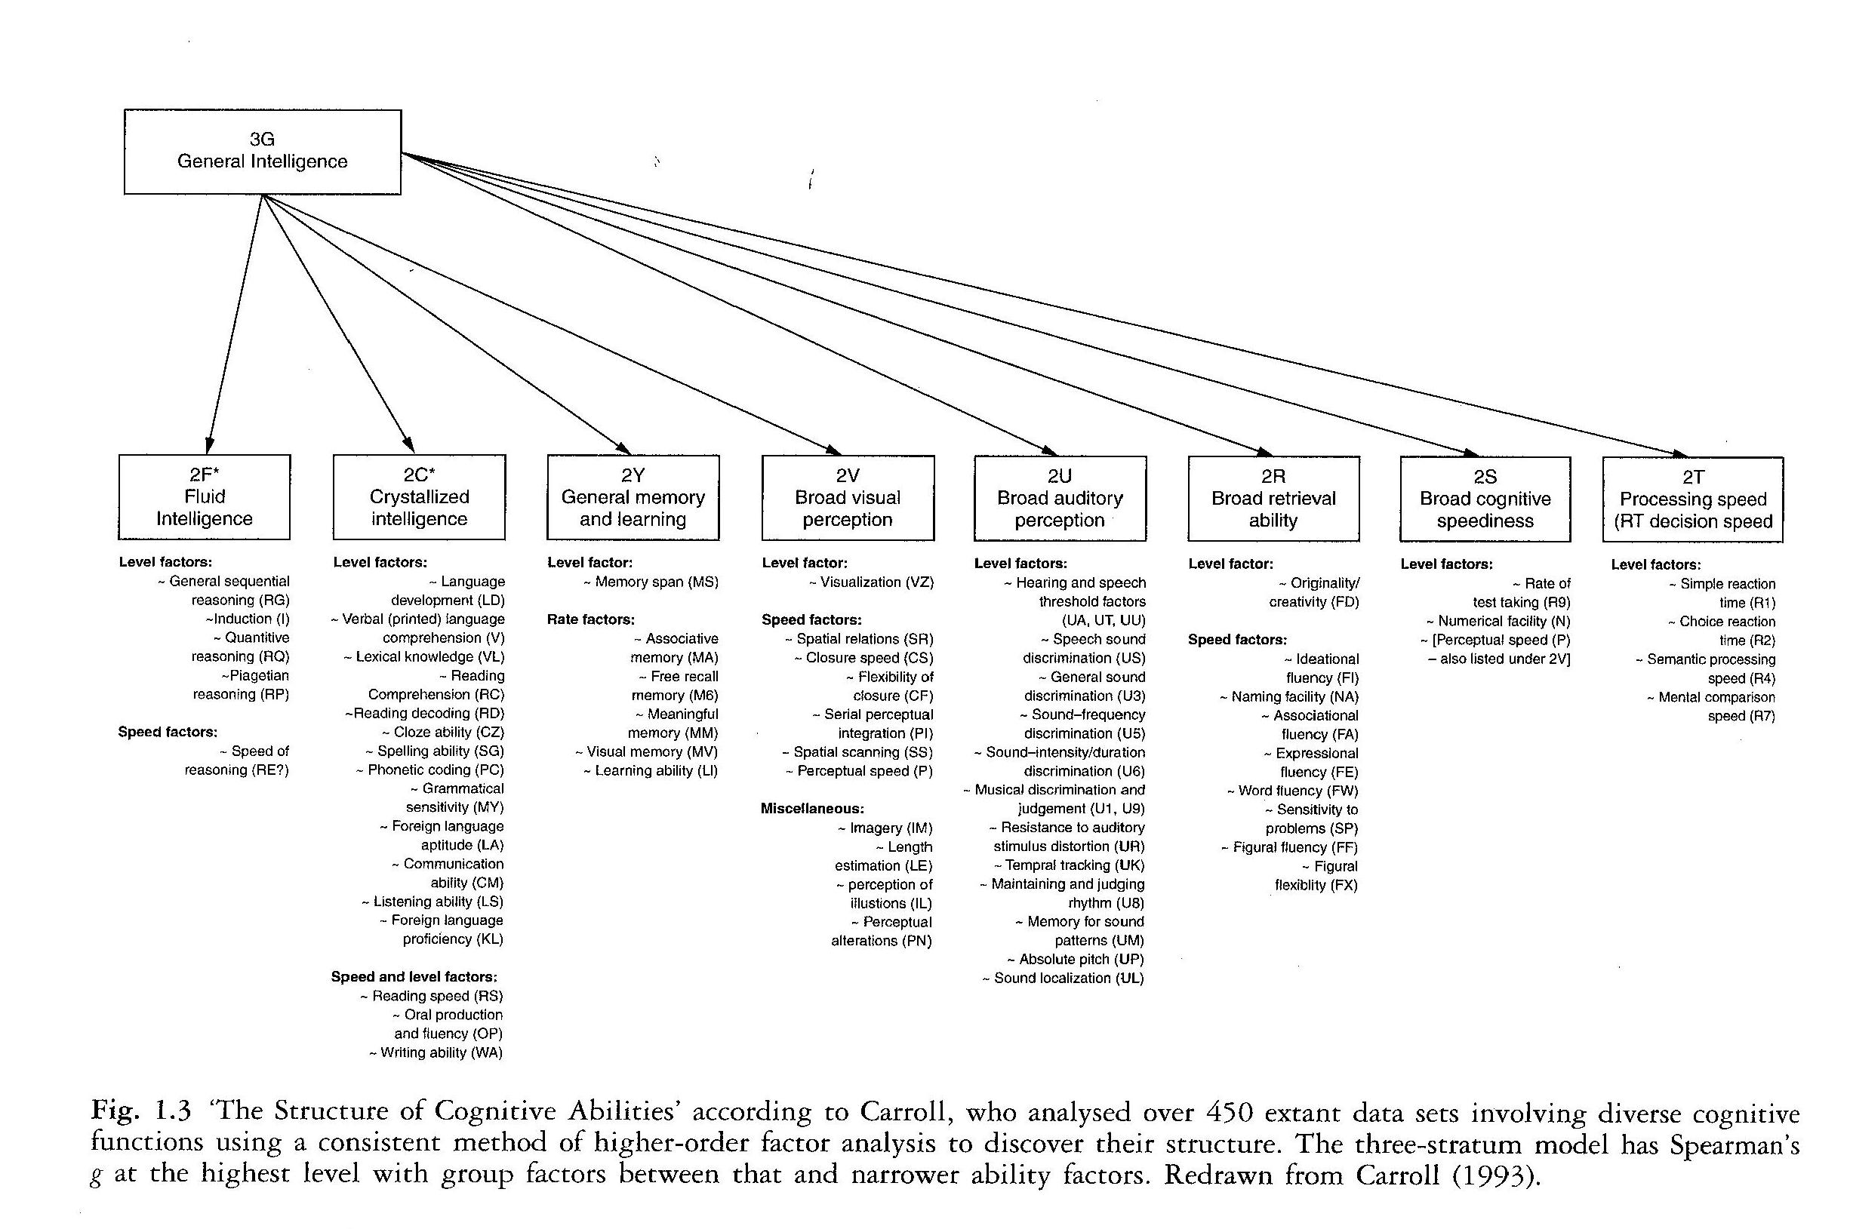
CAPABILITY
Enabling good work

Slide 172
DIFFERENTIATED ABILITIES: THE CONSENSUS MODEL
At the bottom we find Carrol’s 69 single abilities,
at the middle layer some 10 “group factors” and,
at the apex: Little g.

Slide 173
THE BATTLE OVER HOWARD GARDNER & “MULTIPLE INTELLIGENCES” (1)
Digression: the strife (between proponents of g versus proponents of group factors) was repeated
(senselessly, in my view)
when 50 years later Howard Gardner advanced a model of
“multiple [and NB: allegedly independent] intelligences”
(thus implicitly rejecting, i.a., Arthur R. Jensen).

Slide 174
TWO QUOTATIONS
“It appears that all the most important events in human history have somehow occurred twice.”
― G. W. F. Hegel
“Sure. The first time a tragedy, the second time a farce.”
― Karl Marx
☺

Slide 175
THE BATTLE OVER HOWARD GARDNER & “MULTIPLE INTELLIGENCES” (2)
Now, Gardner has provided highly stimulating idiographic accounts of the lives of highly creative (or politically influential) people
(which received praised from, i.a., Arthur R. Jensen)
☺
and it goes without saying that his approach is helpful to teachers and other educators!

Slide 176
THE BATTLE OVER HOWARD GARDNER & “MULTIPLE INTELLIGENCES” (3)
But: Gardner’s focus is on genius
in which single abilities (and not just “the positive manifold” of g) are crucial ―
and he has rejected statistical testing of his ideas
against data from large representative populations of “ordinary people.”
End of digression.

Slide 177
8 SHORTCOMINGS & LIMITATIONS OF PSYCHOMETRIC RESEARCH
CAPABILITY
Enabling good work

Slide 178
SPEARMAN & THURSTONE BOTH REALIZED THAT F.A. CANNOT REVEAL HOW ABILITIES DO THE WORK THEY DO
Despite their differences, though, Spearman and Thurstone did agree on the limited role of psychometrics-based statistical research:

Slide 179
THURSTONE ON THE ROLE OF FACTOR ANALYSIS (1)
“The exploratory nature of factor analysis is often not understood.
Factor analysis has its principal usefulness at the borderline of intelligence. It is naturally superseded by rational formulations in terms of the science involved.”

Slide 180
THURSTONE ON THE ROLE OF FACTOR ANALYSIS (2)
“Factor analysis is useful, especially in those domains where basic and fruitful concepts are essentially lacking and where crucial experiments have been difficult to conceive.
The new methods have a humble role. They enable us to make only the crudest first mapping of a new domain.”

Slide 181
EYSENCK (1979) ON SPEARMAN (1)
“The isolation of a psychometric and factor analytic work from the experimental and theoretical tradition of psychology has had many unfortunate consequences, which were foreseen by Spearman, who
insisted on the dual psychological study of intelligence: the psychometric study of individual differences, and the experimental study of the general laws of intellectual functioning.”

Slide 182
EYSENCK (1979) ON SPEARMAN (2)
“It is unfortunate that his successors embraced wholeheartedly the psychometric method, and disregarded the experimental method.
It is only recently that the process of unification has begun, and our success in gaining a proper understanding of intelligence depends very much on the continuation of this unification.”

Slide 183
FROM KNOWING “THAT” TO KNOWING “WHY” (1)
To apply Favrholdt’s distinction between three “kinds” of knowledge (which I introduced above):
the results of factor analysis can essentially provide us with a “knowledge that”
(which can be a great start).

Slide 184
FROM KNOWING “THAT” TO KNOWING “WHY” (2)
But since it tell us nothing about the nature of those mechanisms in the mind which perform the actual cognitive operations that constitute the content of a “factor,”
it will rarely in and by itself amount to a causal “knowledge why.”

Slide 185
THERE MUST BE MORE THAN 69 DIFFERENTIATED ABILITIES
While confident that good IQ tests are a lot better than their reputation,
I never the less belong to those who believe that, despite the scope of Carroll’s comprehensive analysis,
there are probably many more differentiated cognitive abilities among human beings
(vis-à-vis IQ tests currently available at the market are also “blind”)!
than the 69 which he found.

Slide 186
AN ANALOGY: A BIOLOGIST SORTING A CATCH OF FISH …
Let us imagine a biologist trying to establish a cladistic tree of the evolution fish species
using a catch that he finds in a fisherman (f/m) ’s net as his empirical sample:
The (few) cladistic branches that he can identify may be perfectly valid ―
but many others are likely to be missing.

Slide 187
… AND A STATISTICIAN SORTING OUT A CATCH OF PSYCHOMETRIC TEST RESULTS
Analogously, exploratory and confirmatory factor (or other regression) analysis of answering patterns from psychometric tests
can only identify real-world abilities (or temperament traits)
that test items inquire about in the first place …

Slide 188
MANY HUMAN ABILITIES HAVE SOCIAL ORIGINS, THEY SAY
… and since many evolutionary psychologists and anthropologists believe that complex social interaction has been a strong driver for many human abilities
it is close to disastrous that standard psychometric IQ tests (such as WAIS) make no attempt to measure our social reasoning, knowledge, or skill …
☹

Slide 189
e.g., THEORY-OF-MIND!
… such as, e.g., our species-specific, sophisticated version of what is now called “theory of mind”
(e.g., our grasping the intentions of others, our practicing advanced co-intentionality, or our detecting liars and “free riders”) ―
very important capabilities to which existing IQ tests are plainly oblivious!
☹

Slide 190
READING FACES

Slide 191
e.g., MORALITY!
Or take our suave understanding of dilemmas in ethics and morality ―
i.e., our ability to actually handle, in actual practice, competing & contradictory situation- and “agent-relative” values ―
which probably has evolved as two separate systems,
applying to small groups (e.g., family & kin) and large society, respectively.

Slide 192
SELF-COMPLACENCY
These are areas where I, for one, find it difficult to swallow the self-complacency of the psychometric IQ community.
☹

Slide 193
9 A “PROXIMATE” EXPLANATION OF THE “POSITIVE MANIFOLD”
CAPABILITY
Enabling good work

Slide 194
WHAT IS THE PROXIMATE EXPLANATION OF THE “POSITIVE MANIFOLD”?
But what sort of proximate mechanism (or mechanisms, or properties) of the brain could explain the “positive manifold,”
i.e., positive correlation of the strengths of differentiated abilities in single individuals,
and thus also the statistical g-factor?

Slide 195
INTRA-GROUP VARIATION & BETWEEN-SPECIES DIFFERENCES (1)
I repeat: g is “distillate” of intra-group variation
― not of between-species differences!
And while we have no a priori reason to believe that whatever causes the positive correlation (of the strengths of differentiated abilities in single individuals) …

Slide 196
INTRA-GROUP VARIATION & BETWEEN-SPECIES DIFFERENCES (2)
… is identical (or even just related) to whatever caused the brains of the Genus homo to add many more neurons to their brain modules (compared to those of chimpanzees and other primates) ―
we also have no a priori reason to assume the opposite: that they are unrelated!

Slide 197
WHAT ABOUT VELOCITY OF SIGNALS?
Now, we might imagine that the brains of some people are endowed with some overall favorable feature ― e.g., velocity of nerve signal conduction?

Slide 198
I DOUBT IT
However I, for one, would deem that option unlikely
since the “speed of travel” of neural signals most likely is the same in the entire nerve system of any member of a given species.
If anything, neurons are surprisingly slow creatures ― a fact that may more easily strike a computer scientist, as the following quote shows:

Slide 199
A COMPUTER SCIENTIST LOOKS NEURONS (1)
“Neurons are quite slow compared to the transistors in a computer.
A neuron collects inputs from its synapses, and combines these inputs together to decide when to output a spike to others neurons.
A typical neuron can do this and reset itself in about five milliseconds (5 ms), or around two hundred times per second.”

Slide 200
A COMPUTER SCIENTIST LOOKS NEURONS (2)
“This may seem fast, but a modern silicon-based computer can do one billion operations in a second.
This means a basic computer operation is five million times faster than the basic operations in your brain!”
― Jeff Hawkins (2004), On Intelligence.

Slide 201
SOUND?!
In fact, neural signals propagate so slowly that a German physicist, professor Thomas Heimburg (from the Niels Bohr Institute of Physics in Copenhagen), has suggested that
neurons may be communicating by means of sound
and not by the electro-chemical mechanism that we have all been taught about.

Slide 202
SPEED OF ELECTRICITY, SPEED OF SOUND
If there is no resistance, electricity will travel at the speed of light: about 300,000 kilometers per second.
The speed of sound depends on the medium through which it is raveling,
but in dry clean air it is approximately 331 meters per second.
The latter figure is much closer to the velocity of nerve signals.

Slide 203
BUT THEN WHAT ABOUT A NON-DOMAIN-SPECIFIC GPU? (1)
Next we might imagine that, in addition to highly domain-specific modules (or DSMs), there also is a (or perhaps more than one) “general processing module” or “GPU”
(similar to the CPU (central processing unit) in our digital computers),
which always assists the DSMs performing their specific tasks …

Slide 204
BUT THEN WHAT ABOUT A NON-DOMAIN-SPECIFIC GPU? (2)
… and that, since the power of this GPU may vary from one person to another
it will either lift or lower all domain-specific performances?

Slide 205
NO, THAT IS STRICTLY TABOO!
In 2004, the Japanese-British economist Satoshi Kanazawa (from LSE) made the mistake of suggesting just that
and was spanked mercilessly for it by Dutch psychometrician Denny Borsboom in 2006
in what some may see as a showpiece of scientific rigor ―
but which came across to me as rather magisterial, though.

Slide 206
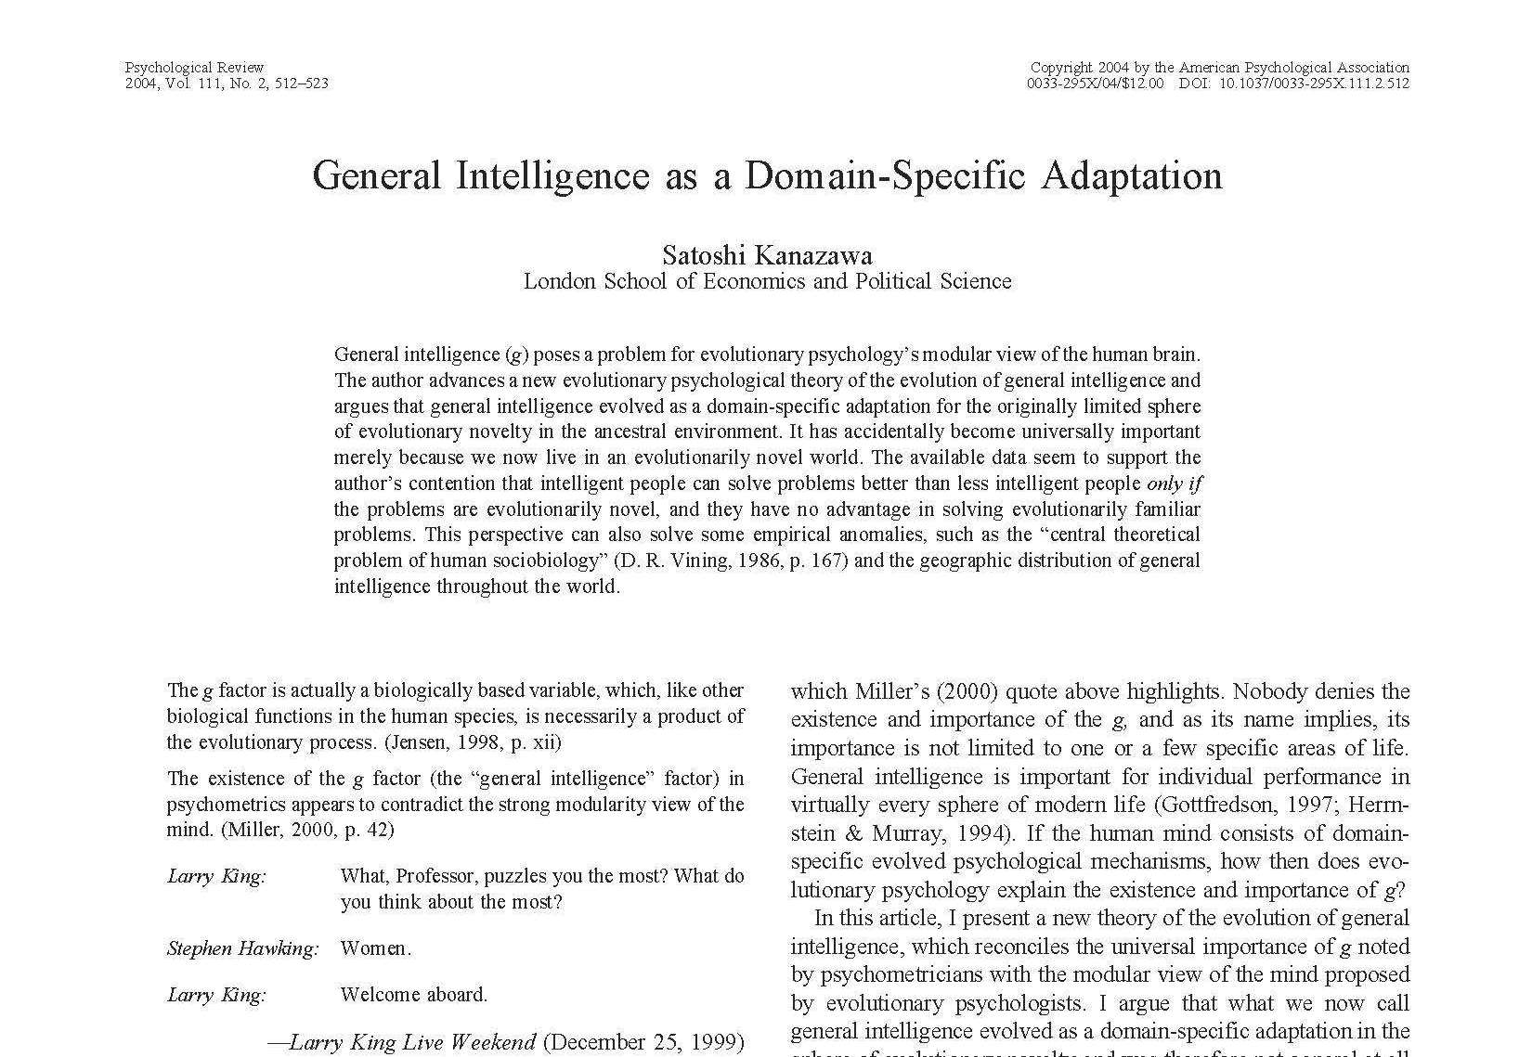

Slide 207
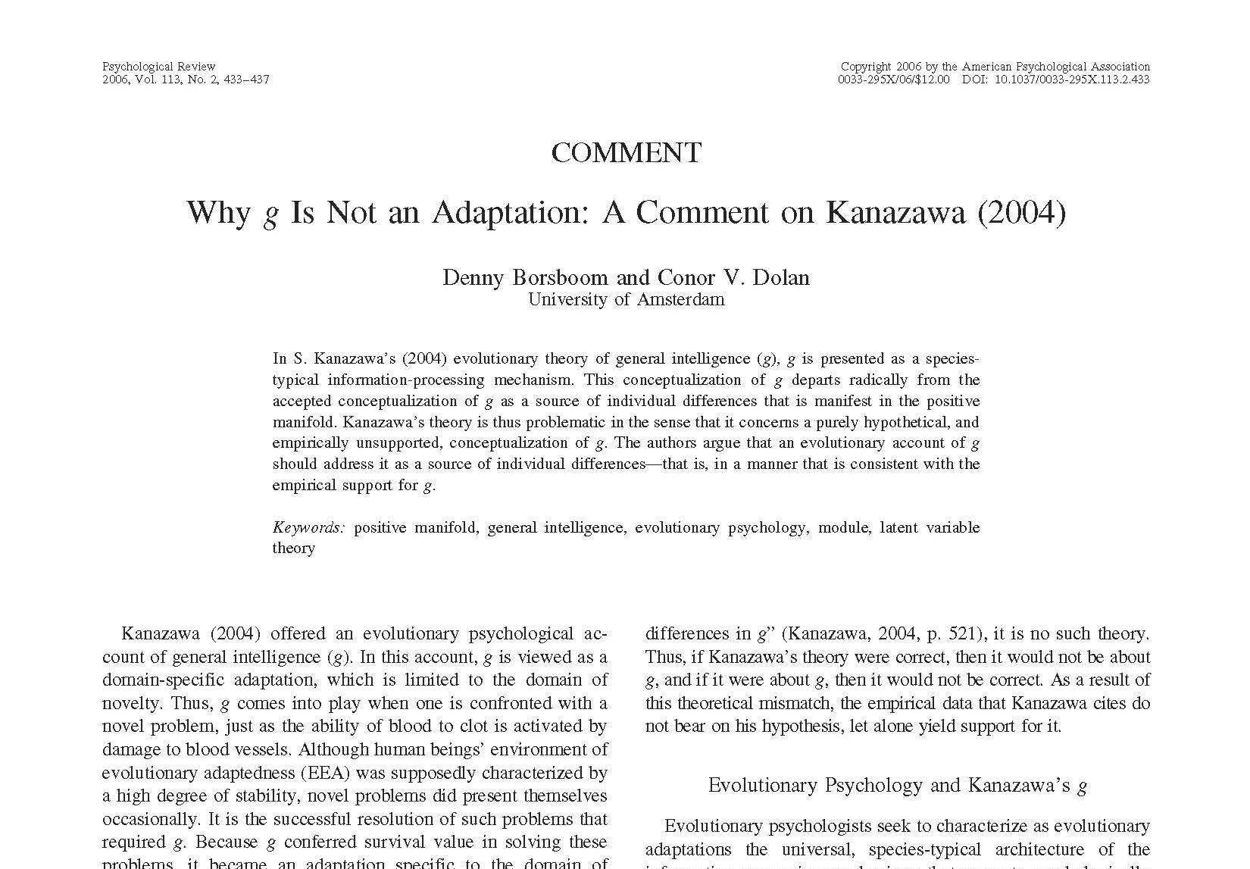

Slide 208
NOT THINKABLE, NOT FEASIBLE (1)
So I myself regret to have to come down quite strongly on the side of the “massive modularity” people as regards this idea:
We cannot possibly imagine a natural or sexual selection pressure
that could “shape” a separate GPU module of this kind!
☹

Slide 209
NOT THINKABLE, NOT FEASIBLE (2)
The reason, I trust, is that
those external situations which, in a positive sense, “select” individuals with certain properties or behaviors for survival
must be relatively uniform and repeated time and again
in order for evolution to do its work ―
and Kanazawa’s “novel” or “surprising” situations, by definition, do not meet that criterion.

Slide 210
A “GPU” MODULE ≠ A COORDINATING CONDUCTOR
Nota bene: such a “GPU” module would be quite another thing than our pre-frontal coordinating module
(which acts in a fashion similar to an orchestra conductor, or to the coordinating “second-order specialists” of social science)
which I spoke about in my introduction.

Slide 211
PRE-FRONTAL CORTEX NOT PROPORTIONALLY LARGER
And, by the way: While the evolutionary sequence that lead from
Homo habilis → H. ergaster → H. erectus and, finally (?), → H. sapiens
added more neurons to all modules or circuits in the cortex,
it did not add proportionally more to its pre-frontal part.

Slide 212
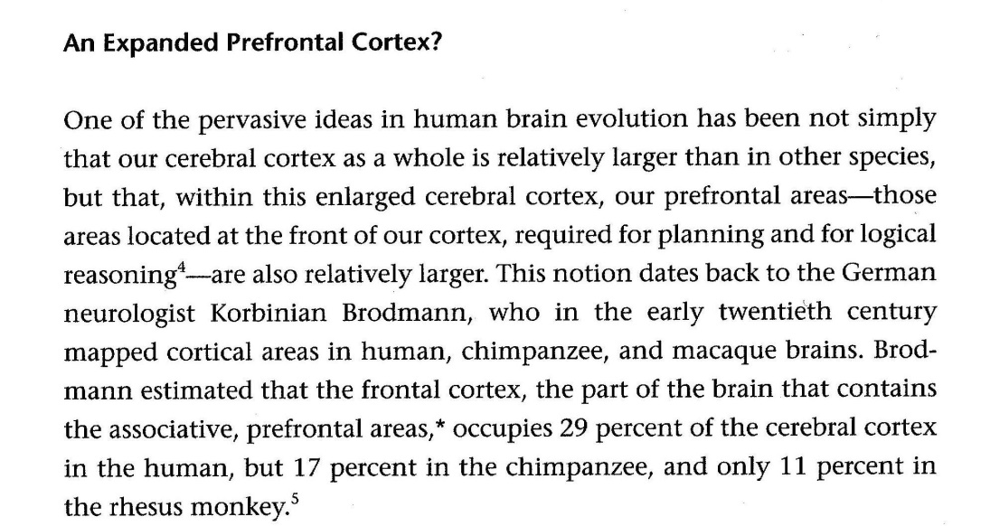

Slide 213
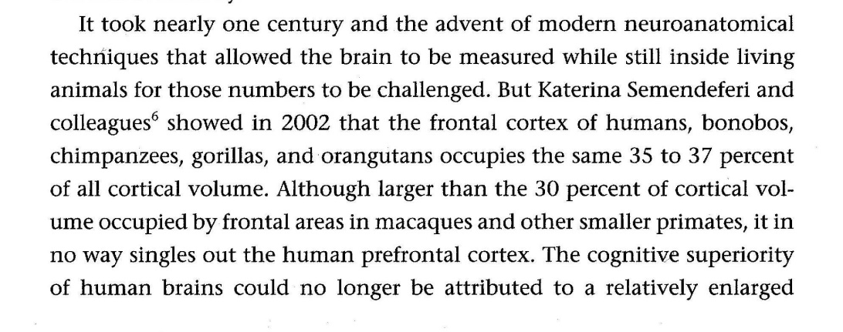

Slide 214
HERE’S THE THIRD OPTION, THOUGH ― WHICH MUST BE TRUE! (1)
This more or less leaves us with a third option, for which I will cast my lot:
There is a positive manifold or correlation between the strengths of the workings of different, highly domain-specific brain modules
as well as between these and the coordinating modules located in the pre-frontal lobe …

Slide 215
HERE’S THE THIRD OPTION, THOUGH ― WHICH MUST BE TRUE! (2)
… because:
if one of these modules (or circuits) contain either a larger or smaller number of neurons
then the same will be true for all other modules (or circuits).

Slide 216
A “QUALE”?
NB: The presence of an abundance of very different, and very domain-specific abilities
that we quickly and automatically switch on or off whenever external situations call for it
may well create an illusion (or better: a quale) in our minds that we also do possess a “general” ability (or GPU)
(which can be applied to any type of external environment or situational aspect )!

Slide 217
BUT WHAT ABOUT THE ULTIMATE EXPLANATION?!
Phew ― we got the proximate explanation right!
☺
But what about the ultimate explanation?!
☹
Don’t worry! Coming up! (In my coda.)
But first we have to take a look at what drives differentiation.

Slide 218
Part III INTRICACIES FROM EVOLUTIONARY BIOLOGY
CAPABILITY
Enabling good work

Slide 219
10 SELECTION PATTERNS, COST/BENEFIT RATIOS FOR PROPERTIES ― and other ultimate drivers of within-species & between-species differences
CAPABILITY
Enabling good work

Slide 220
WHAT DRIVES “WITHIN-SPECIES” DIFFERENTIATION OF HUMAN COGNITIVE ABILITIES?
We (or rather I) just spoke at some length about differing human cognitive abilities and why they, statistically speaking, are positively coordinated
― and I claimed (perhaps foolhardily) that the proximate cause must be that
if brain module 1 contains a larger number of neurons in person NN than in person MM,
then the same will tend be true for all their other brain modules (2, 3, &c).

Slide 221
WHAT ARE THE “ULTIMATE” CAUSES?
But what are the ultimate causes for this?
How come evolution created abilities which:
from a qualitative point of view, appear to be identical, but can
have quantitatively different strengths in single individuals, and yet
still remain positively correlated (in “the big picture”)?

Slide 222
BETWEEN-SPECIES & WITHIN-SPECIES DIFFERENTIATION SHARE THE SAME DRIVERS
Or, in other words: What sort of processes drive within-species differentiation?
The short answer is: Basically the same kinds of processes that have driven between-species differences.
The purpose of this “chapter” is to take a look at some of them.

Slide 223
CHAPTER 9 SUBHEADINGS (1)
Life
Cells & genes & cell specialization
Evolution
Proximate & ultimate causes why within-species differentiation of properties (and many behaviors) tends to conform to a bell curve
Evolutionary selection patterns

Slide 224
CHAPTER 9 SUBHEADINGS (2)
Evolutionary selection patterns & human gender differentiation
Directional selection & whole-species evolution
Quantity, quality, proportionality: Brain size & number of neurons
Natural (and, where present, sexual) selection never ends

Slide 225
Life
CAPABILITY
Enabling good work

Slide 226
FUNCTIONAL KINDS, MATERIAL KINDS
Philosophers of science often discern
“functional kinds” (such as pendulums or planets)
from
“material kinds” (such as neutrons or neurons) …

Slide 227
WHAT IS LIFE? A PRESENT-DAY DEFINITION
… and present-day biology appears inclined to define life in functional terms.
For example, the British biologist John Maynard Smith (1920-2004) wrote that:
“Entities are alive if they have the properties of
multiplication,
variation, and
heredity
(or are descended from such entities).”

Slide 228
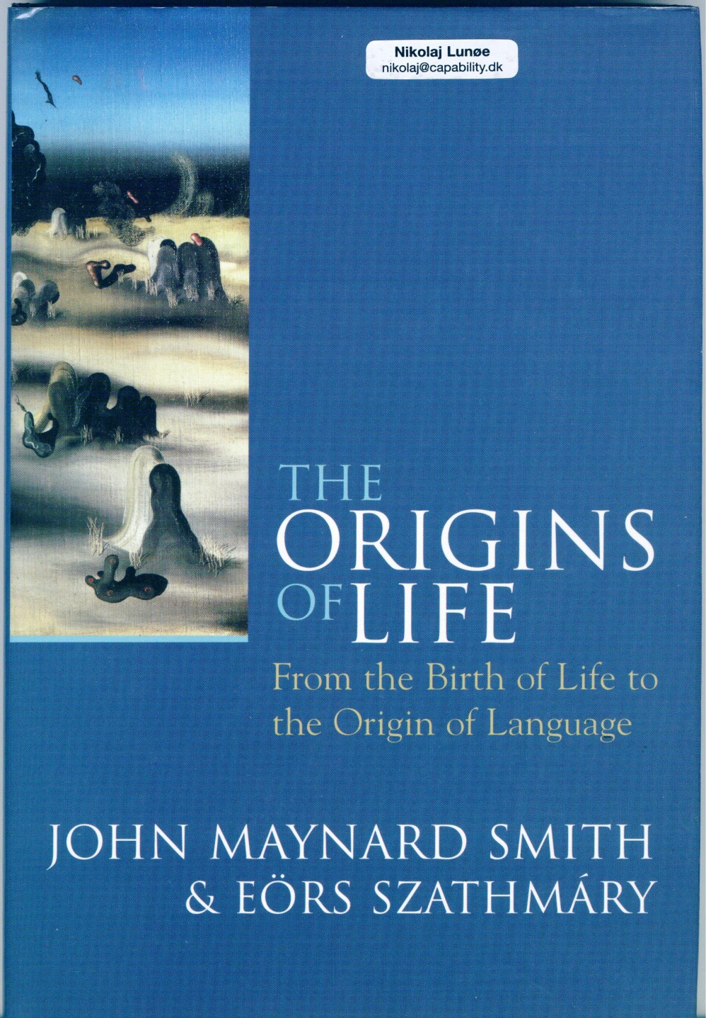

Slide 229
WHY DON’T WE JUST LIVE FOREVER? (1)
All life forms that we know of are divided into generations.
If living cells (or organs, or organisms) should live forever,
they would need to have means for adapting themselves endlessly
to permanent changes in their environments.

Slide 230
WHY DON’T WE JUST LIVE FOREVER? (2)
This would require that cells could somehow deliberately and intentionally re-write the information stored in their genomes ―
based on (other) information about good and bad experiences, received from organs and entire organisms
(and not just select those parts of the genetic information that they want to apply for their synthesis of proteins) …

Slide 231
WHY DON’T WE JUST LIVE FOREVER? (3)
… and multi-cellular organisms would have to find ways to re-write the information stored in ALL of their cells simultaneously!
We know of no life forms that are capable of doing anything of the kind.

Slide 232
Cells & genes & cell specialization
CAPABILITY
Enabling good work

Slide 233
AGENCY
For what it’s worth, I belong to those who prefer to think of biological agency
as something that can only reside with the entire cell “machinery,”
and/or with organs, or with an entire whole organism,
but not in any genome or single gene.

Slide 234
WHAT IS A GENE?
We may think of
the genome as a sort of cookbook which contains all the recipes necessary for building an organism, and of
single genes as references to elementary operations and/or biochemical substances necessary for cooking up a “meal.”

Slide 235
THE COMPARISON HALTS
But the comparison halts because:
all elements of the same coherent recipe (for a specific “meal”) are not neatly and discretely located next to each other (at the same chromosome), and
a single gene, positioned at the same locus, may be involved in recipes for many different “meals” (or rather: types of proteins).

Slide 236
LIMITS OF GENETIC ENGINEERING?
If I have understood a friend (who works with genetic plant engineering) correctly, this is what makes his business difficult ―
and the same fact would probably make it an arduous task to try apply, e.g., CRISPR for improving human (or other animal) intelligence genetically
without obtaining all sorts of adverse “side effects.”

Slide 237
CELL SPECIALIZATION
Some genetic sequences are recipes for “household” proteins that are indispensable to the proper functioning of any cell in a particular species.
But others are only relevant for the production of proteins that will help the cell perform highly specialized functions ―

Slide 238
CELL SPECIALIZATION
… such as turning itself into:
a red or white blood corpuscle; or into
a X, Y or Z type of neuron in the eye’s retina; or into
a hippocampus neuron,
and so on and so forth.

Slide 239
WHAT IS EPIGENTICS? (1)
Since every cell in a multi-cellular organism contains an identical copy of the same genome
(that is: until a mutation occurs),
cells need mechanisms for de-selecting irrelevant “recipes” ―
as well as means for inter-cell communication
that will assist them in positioning themselves at the right place, in the right organ ―
and to know what their neighbor cells are up to.

Slide 240
WHAT IS EPIGENTICS? (2)
This process is what biologists refer to when they speak of “epigenetics.”
(“Transgenerational epigenetics” (which has recently become peculiarly popular among lay folks) is a (very) special case.)

Slide 241
EVOLUTION & DEVELOPMENT
The problem of cell specialization and of “morphogenesis,”
(i.e., of how stem cells and embryos grow and develop into complex, multi-organ organisms
with extremely varied and, sometimes, hard-to-predict behaviors)
is currently a topic much studied ―
and, so far, remain much less well understood than the evolution of the species.

Slide 242
NEURONAL EPIGENTICS?
But is it only me, or do we rarely hear news about
how neurons may specialize in order to adapt themselves to the “needs,” as it were, of domain-specific (or prefrontal “executive”) brain modules?
(I, for one, hear a lot more about the, allegedly endless, “plasticity of the brain” ― but that can hardly be all there is to it, can it?)

Slide 243
Evolution
CAPABILITY
Enabling good work

Slide 244
WHAT DRIVES EVOLUTION?
Biological evolution is driven by two groups of processes:
Those that are internal, and those that are external to the organism.

Slide 245
EVOLUTION: INTERNAL MECHANISMS (1)
Internal mechanisms comprise:
mutations, which are present in all living organisms, and which will
introduce random new elements to genetic “recipes”
(thus perhaps changing the types of proteins synthesized ― and ultimately: the behavior of organs and organisms).

Slide 246
WHAT DO WE MEAN BY “RANDOM”?
We speak of mutations as “random”
not because they are what some philosophers would call a “causa sui” phenomenon
(i.e., “effects” which ostensibly have no “causes”),
but because the sum total of mutations (and their effcts) does not evince any shared direction.

Slide 247
EVOLUTION: INTERNAL MECHANISMS (2)
In sexually reproducing, multi-cellular species
only mutations occurring in gamete DNA
will influence the shape and behavior of future generations.
In such species, internal “drivers” may also include the
recombination of existing elements
provided by the two “lotteries” inherent in meiosis and fertilization.

Slide 248
EVOLUTION: EXTERNAL MECHANISMS
External mechanisms comprise
genetic drift, and
natural and sexual selection.
The latter, in particular, come in all sorts of shapes and forms and, below, I will discuss a some of them.

Slide 249
THE BATTLE IS NOT YET OVER
Evolutionary biology has not yet arrived at a “final” or “complete” understanding of its subject matter.
For example, professionals have long conducted fervent debates about the relative weight or influence of internal and external aspects, and still do ―
and I would say that the lively (sometimes hostile) debates and all the “unfinished business” are what makes the whole thing so interesting.

Slide 250
MUTATIONS ARE COPYING ERRORS
Mutations are = DNA copying errors.
They occur in every gene at every locus in the genome of all living cells
at the same, identical frequency.

Slide 251
BALANCING STABILITY & CHANGE
Some evolutionary biologists believe that
if copying errors occurred more frequently
then life would become too fickle to be able to sustain itself ― and that
if they happened less frequently
then life would become too rigid to be able to adapt itself to changes in its non-living environment.

Slide 252
THE CELL’s QC DEPARTMENT
Be that as it may, cells do spend a lot of time performing “quality controls” and correcting copying errors,
and have developed very sophisticated technologies for doing so.

Slide 253
Proximate & ultimate causes why within-species differentiation of properties (and many behaviors) tends to conform to a bell curve
CAPABILITY
Enabling good work

Slide 254
PROXIMATE & ULTIMATE CAUSATION: A MOST FAMILIAR CASE
Now, allow me to illustrate the concepts of “proximate” and “ultimate” causation with an example
(one which perhaps may be almost too familiar to members of this society) ☺ ―
and at the same time prepare for a discussion of cases of within-species differentiation (and differential ψ).

Slide 255
BELL CURVES Abilities & personality traits are normally distributed

Slide 256
FIRST “LIVING HISTOGRAM” (1901)

Slide 257
SAME GROUP, ONE-DIMENSIONAL POSITIONING

Slide 258
THE “NORMAL” DISTRIBUTION
We know that the size of most bodily properties (e.g., height, birth weight)
and the magnitude (i.e., frequency, strength, and duration) of most psychological behaviors (e.g., extraversion, IQ)
both tend to be “normally” distributed in the general population.

Slide 259
PROXIMATE CAUSE: QTL “RECIPES”
The proximate explanation is that such bodily properties are built from QTL “recipes”:
“QTL = quantitative trait loci =
genes of various effect sizes in multiple-gene systems that contribute to quantitative (continuous) variation in a phenotype.” (Plomin & al 2001)

Slide 260
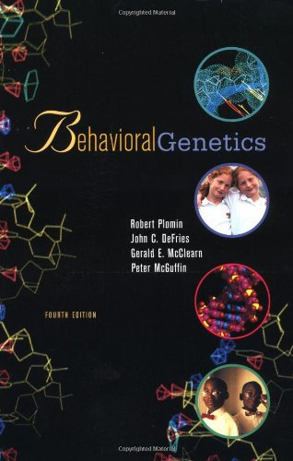

Slide 261
EDUCATIONAL ANALOGY: TOSSING COINS
The textbook analogy used to explain (to innumerate heads ― such as yours truly)
how a QTL recipe inevitably will create a Gaussian (or a skewed, “ex-Gaussian”) normal distribution
is that of
tossing two coins (or more) a hundred times (or more).

Slide 262
HEADS OR TAILS? (1)
When tossing four coins simultaneously, they can come down in a total of 16 different combinations.
We can divide these into five groups — based on the number of “heads” and “tails” in each outcome
There is only one way that we can get either four heads of four tails: HHHH and TTTT. So they will tend to only occur in 1 out of 16 instances.

Slide 263
HEADS OR TAILS? (2)
There are, however, four different ways in which we can have 1 heads and 3 tails (namely HTTT, THTT, TTHT, and TTTH). So this outcome will tend to occur in 4 out of 16 instances (i.e., 25% of all “rounds”).
And so on and so forth…
☺

Slide 264
HEADS OR TAILS? (3)

Slide 265
APPROACHING JND
If we keep the size of the visual figure while adding more coins
the histogram will, to the human eye, appear increasingly smoother —
until, ultimately, we reach a point below that which, to us, constitutes a JND (= “just noticeable difference”).

Slide 266
HEADS OR TAILS? TWO COINS

Slide 267
HEADS OR TAILS? FOUR COINS

Slide 268
HEADS OR TAILS? SIX COINS

Slide 269
HEADS OR TAILS? TWELWE COINS

Slide 270
HEADS OR TAILS? SIXTEEN COINS

Slide 271
NOW, LET GENES REPLACE COINS, AND ALLELES REPLACE HEADS & TAILS!

Slide 272
GENERAL PROXIMATE CAUSE OF WITHIN-SPECIES DIFFERENTIATION
This is the general proximate causal mechanism regulating within-species differentiation of properties and behavior.
Adding environmental (“nurture”) influences will only reinforce differentiation
and its tendency to form a (more or less symmetrical) bell curve shaped distribution.

Slide 273
WE WILL RETURN TO THE TOPIC OF HEIGHT & GENDER
As regards the specific topic of height
geneticists have, so far, identified some 697 QTL genes that appear to be involved in its regulation ― and
below, I will discuss the ultimate cause that men, on average, are taller than women.

Slide 274
CAN GENES INFLUENCE Ψ BEHAVIOR?
Genes are recipes for cell behaviors (not multicellular-organism psychological ditto).
But since ψ behaviors are created and controlled by somatic organs
which in turn have all been built in accordance with some genetic recipe
genes may never the less indirectly influence ψ behavior ―
and there can be little doubt that they do.

Slide 275
ULTIMATE CAUSE
Now, answering the question about the ultimate cause for normal distributions
would be tantamount to delivering an account of
how genetic QTL mechanisms ever evolved in the first place
(which may have happened already when the very first multi-cellular, eukaryote-based organisms emerged).

Slide 276
SO: MAYBE YOU SHOULD ASK SOMEONE ELSE
That would be a rather long story. ☹
I am not sure I could relate it (and I believe many details are still not well understood).
So I will restrict myself to another, more modest example of the uses of “applied ultimate explanation”:

Slide 277
NORMAL DISTRIBUTION: THE VERTEX

Slide 278
NORMAL DISTRIBUTION: THE SPREAD & THE TAILS

Slide 279
POSITION OF VERTEX, SIZE OF SPREAD
When asked
why the vertex of the bell curve for a certain property (e.g., birth weight) has become located at a particular position of a measurement scale,
or
why the spread of the overall distribution has the size that it has (whether narrow or wide)
evolutionary biologists will appeal to a slightly more recent variety of ultimate explanation:

Slide 280
SITUATION FREQUENCY & SURVIVAL
The position of the vertex, they explain, represents the “optimal” size of the property in question, i.e., the size that has helped most members to survive ― in most situations, in a not too distant past.
The tails of the bell curve, on the other hand, represent sizes that have helped minorities to survive ― in situations which, perhaps, have been more rare.

Slide 281
Evolutionary selection patterns
CAPABILITY
Enabling good work

Slide 282
EVOLUTION: THREE SELECTION PATTERNS
Biologists have identified three general (or abstract) “selection patterns”
that may result from the interaction of any altered property with its environment
and can “operate” in relation to “natural” as well as “sexual” selection:

Slide 283
EVOLUTION: STRONG SELECTION

Slide 284
EVOLUTION: WEAK SELECTION

Slide 285
EVOLUTION: STRONG & WEAK SELECTION
Strong (or stabilizing) selection will lower the spread in size or strength of a property or behavior
(nota bene: sometimes to the point where within-species differentiation will disappear!),
Weak (or diversifying) selection will do the opposite
(perhaps creating within-species differentiation where before there was none) …

Slide 286
EVOLUTION: DIRECTIONAL SELECTION

Slide 287
EVOLUTION: DIRECTIONAL SELECTION
― while, finally
directional selection will move the mean value and spread of the size of a property
(or the frequency, strength, and duration of a behavior)
either “upwards” or “downwards.”

Slide 288
SELECTION PATTERNS CAN CREATE DIFFERENCES WITHIN & BETWEEN SPECIES
These general selection patterns may, at various moments in time, “operate” on any bodily property and on any somatic or mental behavior ―
thus creating differences
within as well as
between species!

Slide 289
Evolutionary selection patterns & human gender differentiation
CAPABILITY
Enabling good work

Slide 290
WHAT MECHANISM CREATED HUMAN GENDER DIFFERENCE(S) IN HEIGHT?
Let’s start with a well-known and uncontroversial example of how
a sexual directional selection pattern in our past created a “within-species variation” of sorts
to which we have grown so accustomed that we may hardly notice it in everyday life:
gender difference(s) in height.

Slide 291
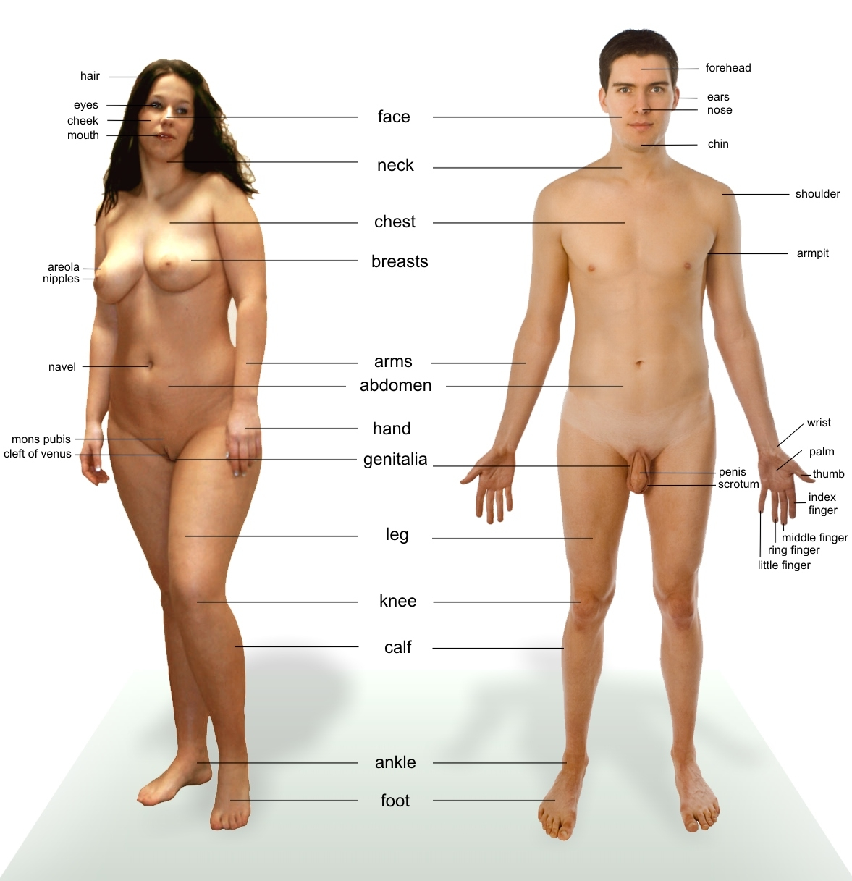

Slide 292
FROM KNOWING “THAT” TO KNOWING “WHY” ☺
We know that the average heights of women and men are different ―
but we also want to know why?
And we can imagine two different varieties of sexual selection which, either separately or jointly, may have created this difference:

Slide 293
FEMALE CHOICE?
Either a combination of male competition and female choice ―
meaning that women must have preferred taller men out of their own free will (which they could done for perfectly good reasons).

Slide 294
INHERETING PROPERTIES ― AND PREFERENCES!
In the bypassing, we should note that for this mechanism to have created the difference in height that we can observe today,
the selection pattern must have been stable across many generations ― which in turn presupposes that
men (but not women) must have inherited the increase in height, while
women (but not men) must have inherited a preference for tall men!

Slide 295
MALE COERCION?
Or a combination of male competition and male coercion ― meaning that
taller and stronger men were able to
prevent smaller men from mating, and to
force women to have sexual intercourse with them.
We know the result ― or: so we would like to think!

Slide 296
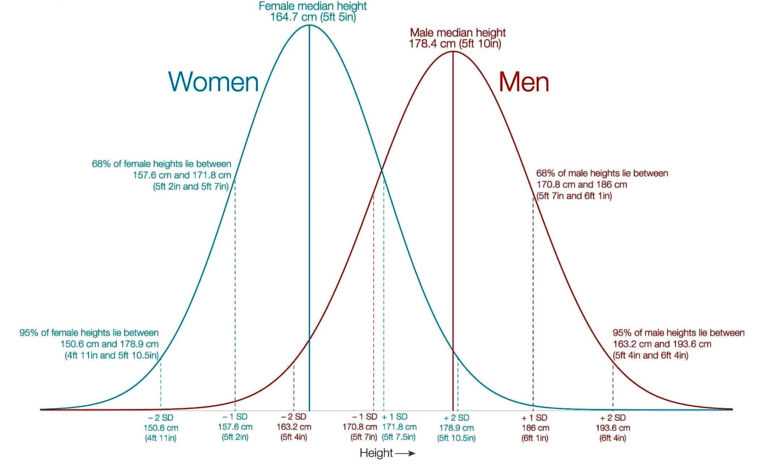

Slide 297
LOWER VORTEX, LARGER SPREAD
But if you take another look at the chart you just saw, you may notice an apparent as well as a less conspicuous difference:
The 12 cm distance on the horizontal axis between the average values of the height of women and men is hard to neglect ― but:
The position on the vertical axis of the vortex of the bell curve for men is slightly lower ― and
the spread of the male distribution a bit wider!

Slide 299
AVERAGE HEIGHTS
According to OWD (Our World in Data), the current global mean height for men is 171 cm, versus 159 cm for women. In other words, the mean height of women is about 12 cm shorter than that of men.
In Denmark, the current average height is about 167 cm for women and about 181 for men (a 14 cm difference) ― making us one of the tallest nations on earth.

Slide 300
697 QTL GENES FOR HEIGHT
So much for the ultimate explanation.
In case you wonder about the proximate cause,
I believe I have already mentioned that, so far,
geneticists have identified some 697 genes that appear to be involved in the regulation of height.

Slide 301
ANOTHER GENDER DIFFERENCE SHOWS THE REVERSE PATTERN
So, gender differences in human height consist of: a marked difference in average + a less conspicuous difference in spread.
But we have statistical data for another human gender difference for which we know the empirical pattern to be the reverse: a conspicuous difference in spread, but no (or a very small) difference in average …

Slide 302
ANOTHER GENDER DIFFERENCE SHOWS THE REVERSE PATTERN
… and for which answering the proximate (i.e., genetic) “why” question appears feasible ―
while it seems rather difficult to answer the ultimate (natural or sexual selection based?) ditto.
☹

Slide 303
IQ

Slide 304
♀ & ♂ & IQ (1)
We have a great deal of evidence to suggest that while
the average IQ scores for women and men probably are roughly the same,
the sub-population of men appear to evince a larger spread.

Slide 305
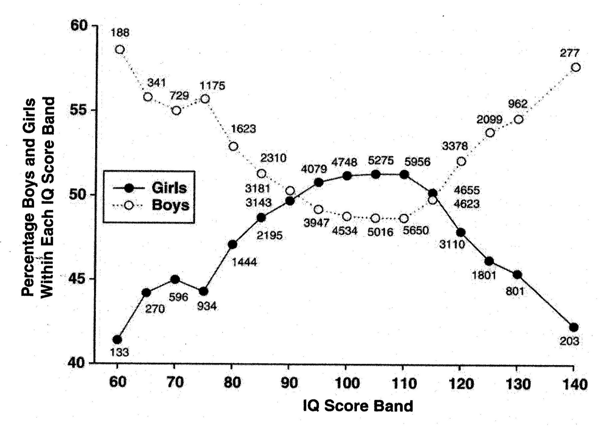

Slide 306
♀ & ♂ & IQ (2)
The (enormous) 1932 data set (N = 87,498 Scottish eleven year olds, all born in 1921)
summarized in the curves plotted onto the coordinate system you just saw
may seem an extreme “outlier” example ―
but at least it makes it hard to overlook the general pattern!
☺

Slide 308
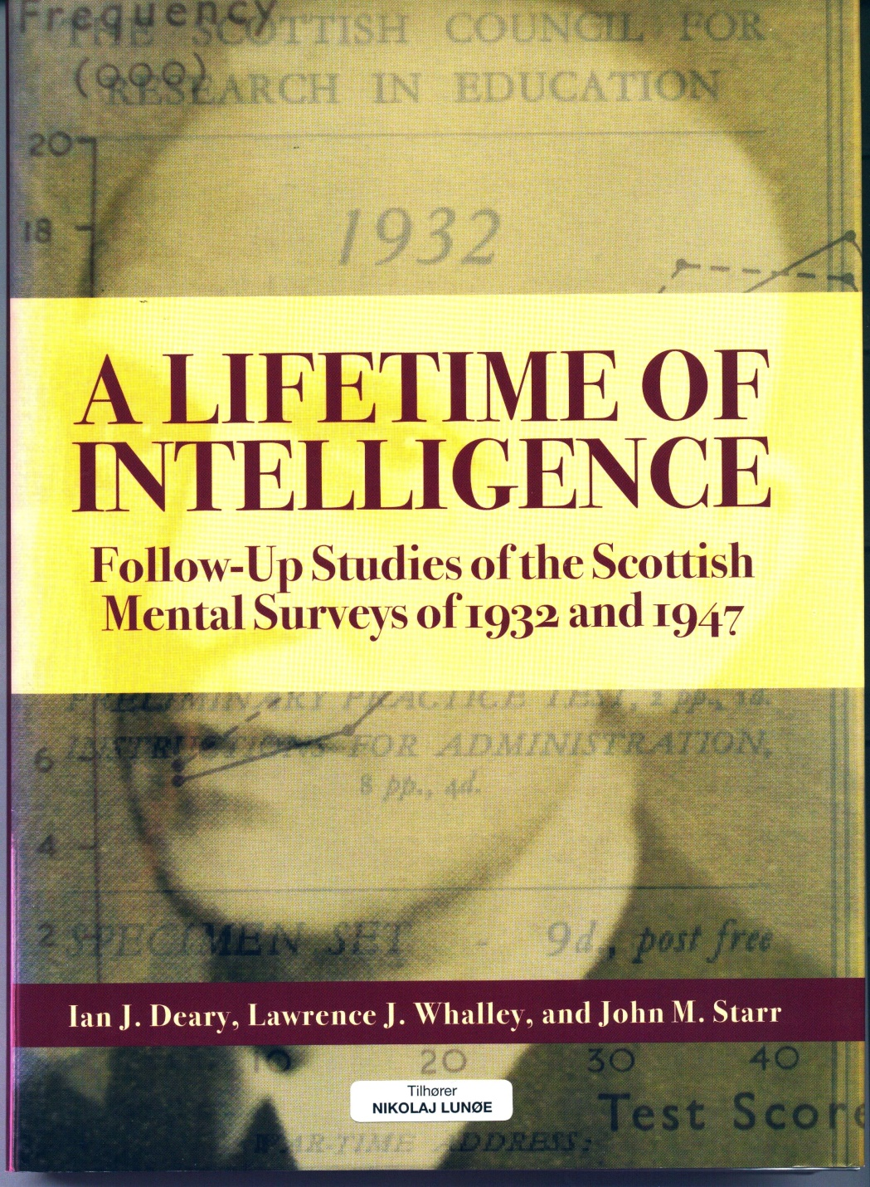

Slide 309
EXPLAINING SAME-SIZE AVERAGE IQ IN ♀ & ♂ (1)
Assuming it is correct that there is no gender difference in size of average IQ
(or that it amounts to only a negligible 1/3 SD
= 5 IQ points)
we may ask why that is so?
Two possible explanations readily suggest themselves
(one of which is selection-based, while the other is “purely” genetic):

Slide 310
EXPLAINING SAME-SIZE AVERAGE IQ IN ♀ & ♂ (2)
Perhaps heterosexual women and men were always equally prone to
attach importance to IQ
when selecting mating partners?

Slide 311
EXPLAINING SAME-SIZE AVERAGE IQ IN ♀ & ♂ (3)
Or perhaps none of the genes which regulate size of IQ (or any “super-switch” for such genes) are located on the X or Y chromosomes ― implying that one gender can never evolve to have a higher average IQ than the other?
(Such an explanation would not necessarily exclude the possibility that a preference for higher IQ in a spouse could still be heritable.)

Slide 312
WIKIPEDIA
If you look up the entry on the “Variability hypothesis” in Wikipedia, you will find a great deal of “knowing that” the spread of IQ distribution is larger for men than it is for women,
but not a trace of “knowing why.” ☹
This may either suggest that there is no consensus among experts ― or that few people have thought about it.

Slide 313
EXPLAINING DIFFERENT IQ SPREADS FOR ♀ & ♂ (1)
To me, it seems be easier to think of proximate causes than of ultimate ditto regarding this phenomenon. Here’s one attempt (cave: technical stuff!):
The number of genes involved in the “epigenetic production” of neurons
(many of which may influence size of IQ in individuals)
is believed to be extremely large.

Slide 314
EXPLAINING DIFFERENT IQ SPREADS FOR ♀ & ♂ (2)
Last year, my perspicacious friend Peter Ulvskov suggested the following: Let us assume that, historically,
heterosexual women have attached more importance to a high IQ in male mating partners than vice versa,
and that a smaller number of the latter (say, 50 %) have fathered most of the progeny.

Slide 315
EXPLAINING DIFFERENT IQ SPREADS FOR ♀ & ♂ (3)
And let us assume that a significant gene (perhaps a super-switch of sorts), which can either raise or lower IQ significantly, is located at the X chromosome ―
and that one “allelic” variant of this gene is strongly “benign” (meaning that it will raise IQ significantly) ― but also (a) very rare, and (b) recessive.

Slide 316
EXPLAINING DIFFERENT IQ SPREADS FOR ♀ & ♂ (4)
The preference in women for mating with high-IQ men would keep this benign allele from becoming extinct.
But women would have to have the “benign” allele present in both of their X chromosomes (in order to obtain the “benefit”) …

Slide 317
EXPLAINING DIFFERENT IQ SPREADS FOR ♀ & ♂ (5)
…. while a man would “hold his own” whenever he had the rare luck of its presence at his X chromosome.
This would explain the longer high-end tail of the IQ distribution for men.

Slide 318
SOME SAY THE PATTERN IS THE REVERSE FOR MALE & FEMALE ORGASM
Some evolutionary sexologists claim that the
propensity of (heterosexual) women and men, respectively, for obtaining a sexual orgasm
demonstrate the reverse pattern ―
i.e., the sub-population of women is evincing a larger spread (and, perhaps, lower average) …

Slide 319
A “JUST SO” STORY?
… and believe that to be the ultimate result of a prolonged diversifying (or “weak”) sexual selection operating on women in our past ―
but others reject such explanations as mere “Just So” stories
(since we cannot know for sure whether behaviors that we can observe today
also were prominent in our distant past).

Slide 321
Directional selection & whole-species evolution
CAPABILITY
Enabling good work

Slide 322
ANTEATERS …
Now let us briefly look at yet another well-known, uncontroversial example
of the result of a “strong” directional selection
― and one that has been “operating” on an entire family of species for millions of years at that …

Slide 323
… AND HUMANS
… and next ask what that particular directional selection
which necessarily must have been operating on the cognitive ability
on several succeeding member species of the Genus homo
(in order to finally come up with one equipped with a 16 billion neuron cortex)
could possibly have been “made of”?

Slide 324
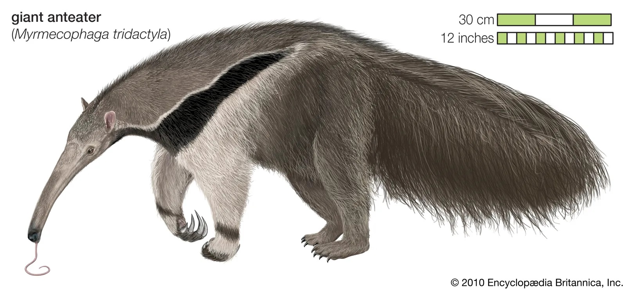

Slide 325
AN “ISOLATING” MECHANISM: ANTS
We may say that not just the nose and tongue, but also the long sharp front claws, as well as the fur of this fella
have all been “shaped” by the availability of one particular “ingestant”: Ants.
And kindly notice: At least 90 % of any ant-“hill” is actually located beneath the surface of the earth!

Slide 326
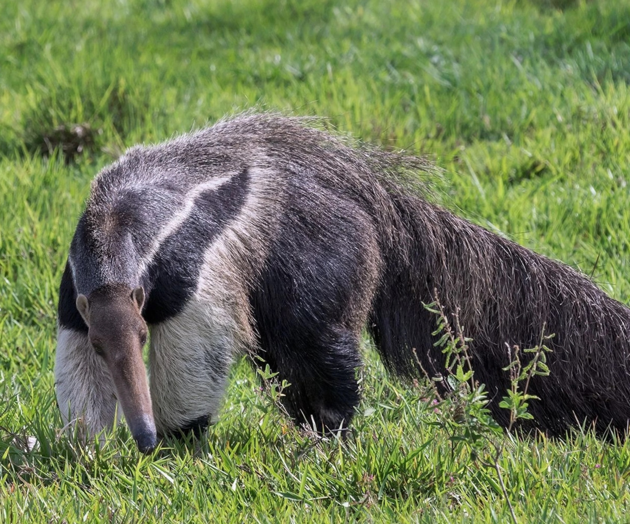

Slide 327
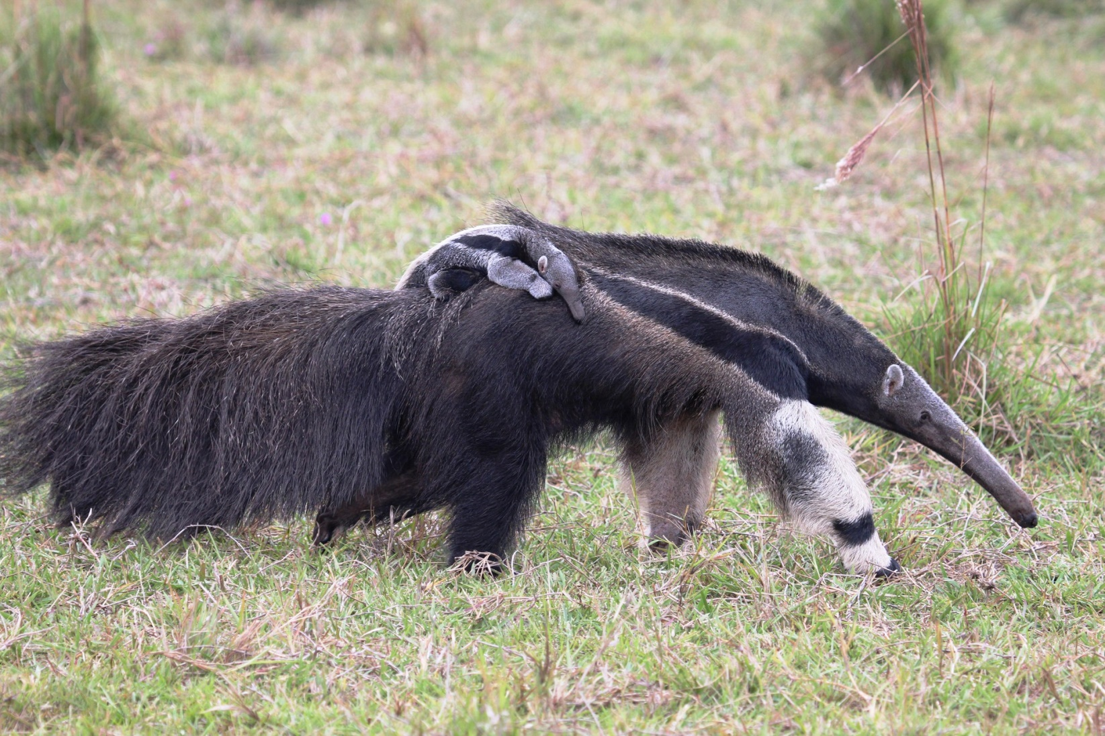

Slide 328
AGENCY IS IN THE ORGANISM
We speak of a “shaping” environment, but I believe it could be more appropriate to locate the actual agency inside of the organism itself (as well as in its component organs and cells) and rather say that
it is the surviving members of her species
who have evolved to make the most of this resource ―

Slide 329
ATOP A “FITNESS PEAK”
… and thus has put itself safely atop a peak in one of Sewall Wright (1889–1988) ’s “fitness landscapes”:
Anteaters are extremely well adapted to a highly specific type of environment ―
and as long as there are plenty of ants (which there are)
future generations of anteaters should be facing a sunny future. ☼

Slide 330
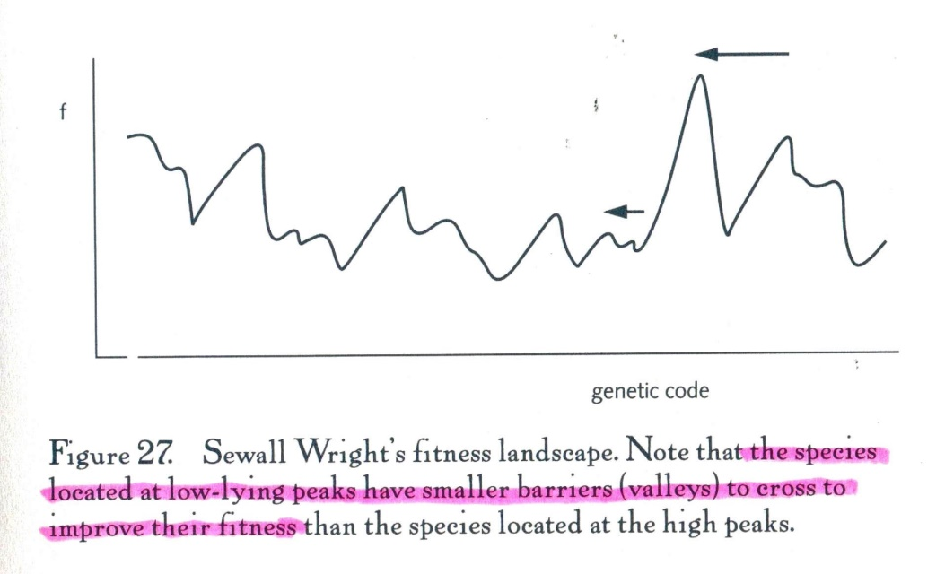

Slide 331
BUT: WHAT ’BOUT US?
But, assuming you agree that what makes us (H. sapiens) special is our cognitive ability,
would you say that our species also resides on a “fitness peak” ―
and if so, how would you describe
the particular type of environment to which we are, supposedly, extremely well adapted ―
and which has “shaped” us (the way the availability of ants “shaped” the anteater)?

Slide 332
Quantity, quality, proportionality: Brain size & number of neurons
CAPABILITY
Enabling good work

Slide 333
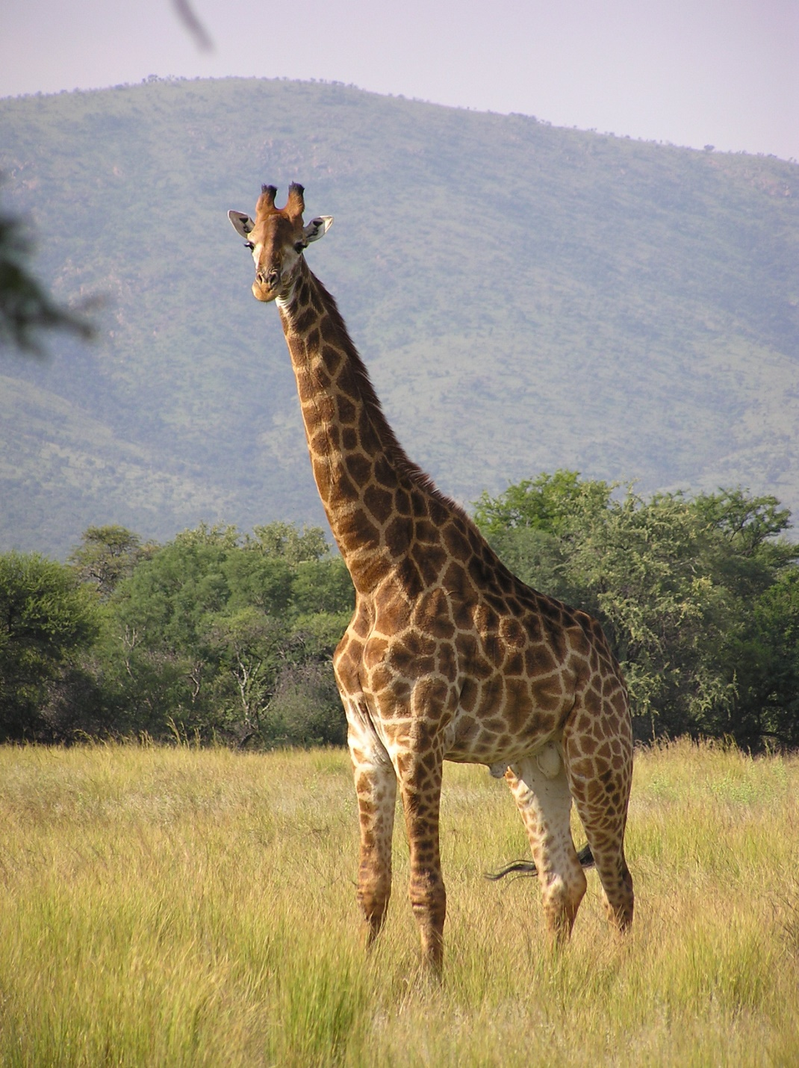

Slide 334
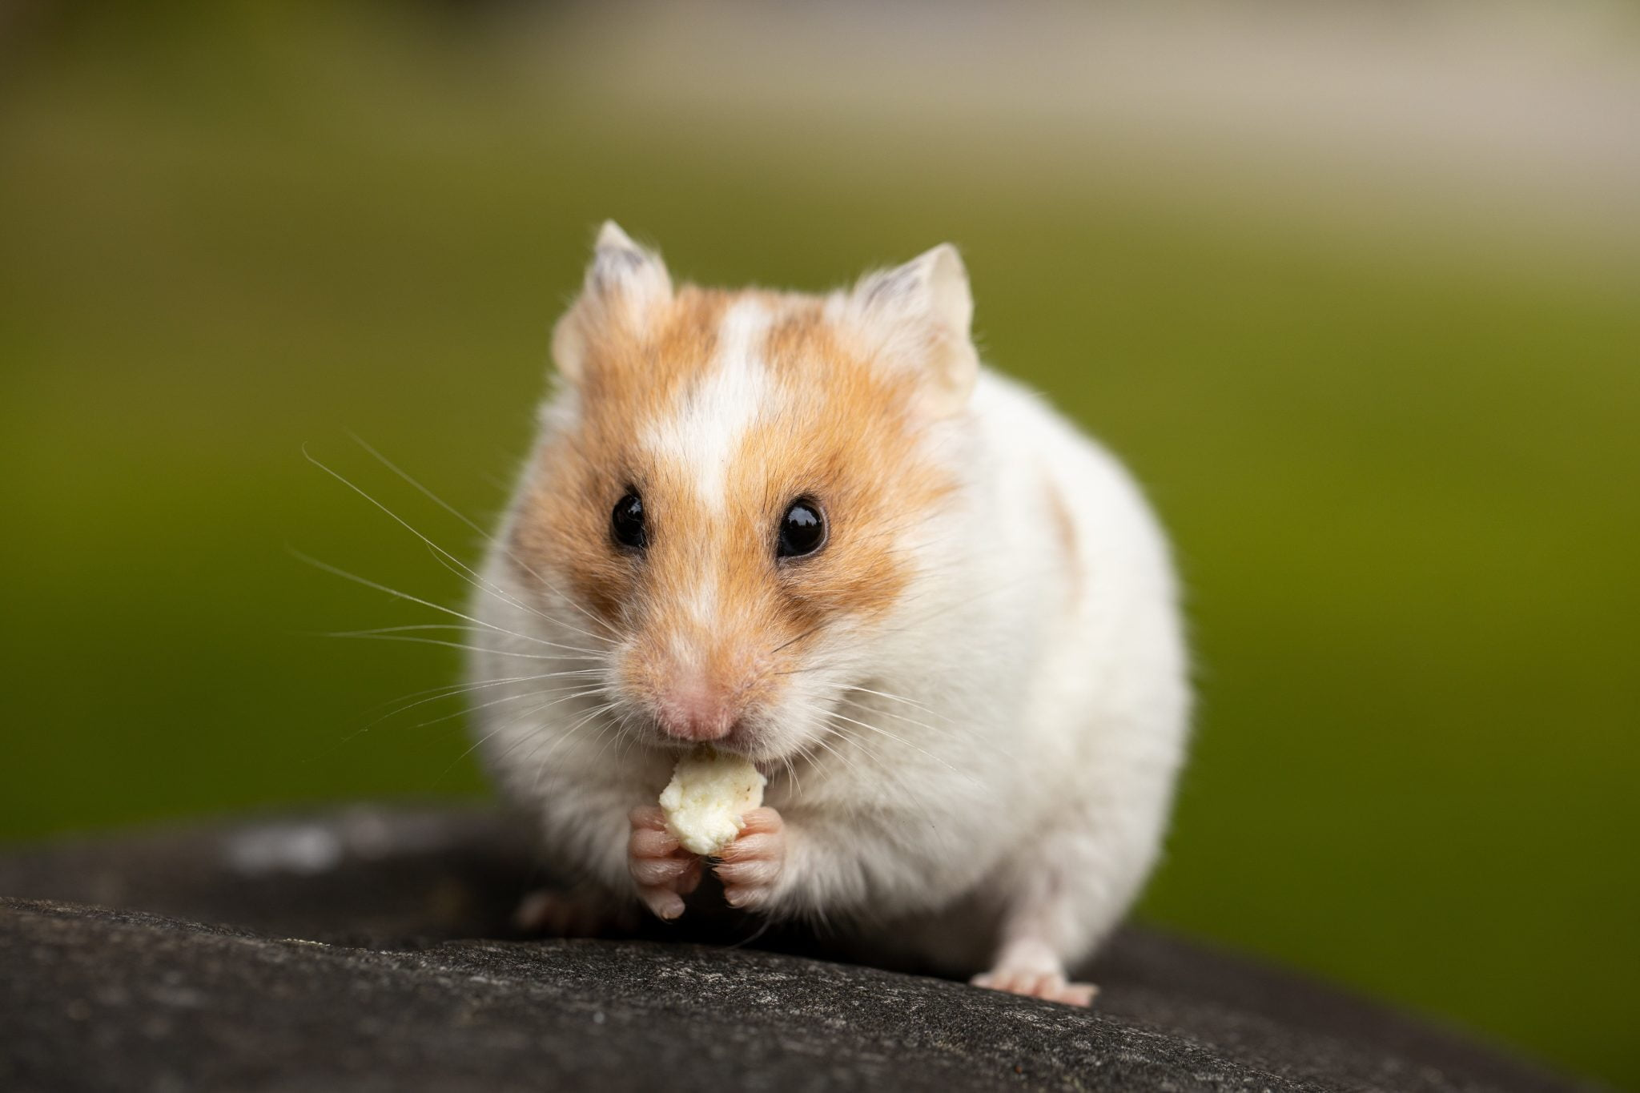

Slide 335
LONG NECK, SHORT NECK
A giraffe has a very long neck.
A hamster has a very short neck.
So here’s a question for you all:
How many cervical vertebrae [Danish: halshvirvler]
would you expect to find inside one and the other of these two animals?

Slide 336
ALL MAMMALS HAVE SEVEN CERVICAL VERTEBRAE
The simple answer is that all mammals have seven
and anatomists have no difficulty recognizing each of them across species.
The giraffe, however, has grown great big cervical vertebrae,
while those of the hamster, like the animal, are tiny.

Slide 337
QUALITY & QUANTITY (1)
This suggests that genetic recipes which, from a qualitative point of view, appear to be identical (or largely identical)
must be controlled by other genetic algorithms or “switches”
that can turn the production of a certain (“epigenetic”) type of specialized cell on or off
so that the organ build from it will become large or small, accordingly.

Slide 338
QUALITY & QUANTITY (2)
Imagine for a moment that a similar genetic algorithm or switch
can turn on or off the production of neurons
during the formation of our brains!

Slide 339
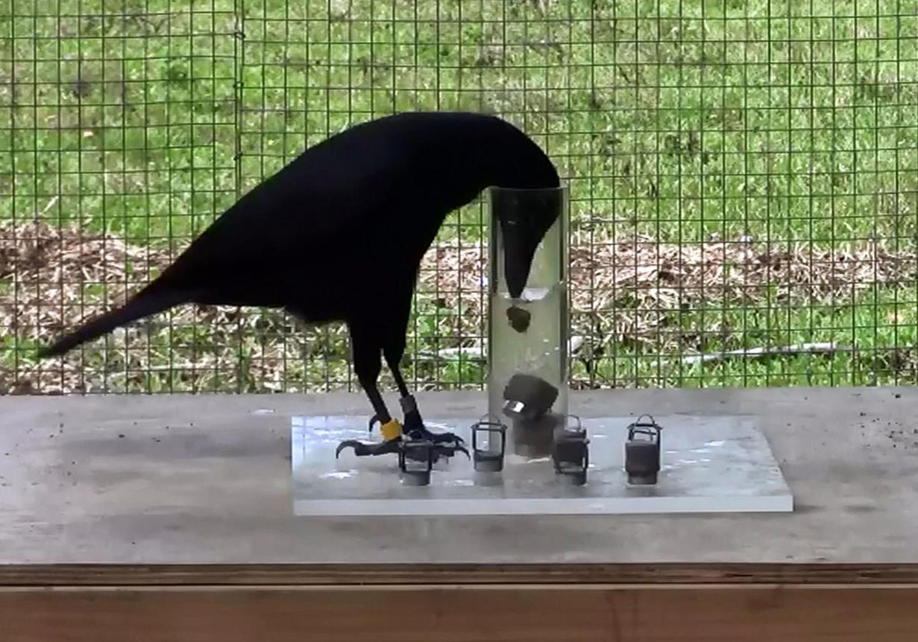

Slide 340
HOW CAN SMALL ANIMALS BE SO SMART? (1)
Did you ever wonder why small animals with small brains
sometimes can do things which suggest that they are every bit as smart as
large animals with large brains?

Slide 341
HOW CAN SMALL ANIMALS BE SO SMART? (2)
The proximate explanation is simple:
Large animals tend to be built from large cells, and
small animals from small cells ―
and this proportionality (or correlation) includes neurons!

Slide 342
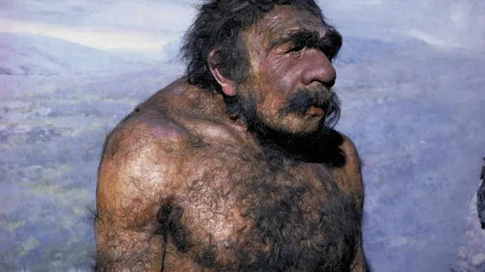

Slide 343
ONE IMPORTANT EXCEPTION …
There is an exception to the rule, though:
Primate neurons are, on average, 9 % smaller than we would expect them to be
if they had stuck to the general rule of proportionality
of body and cell sizes.
Do take a look for yourself at the table on the next slide!

Slide 344
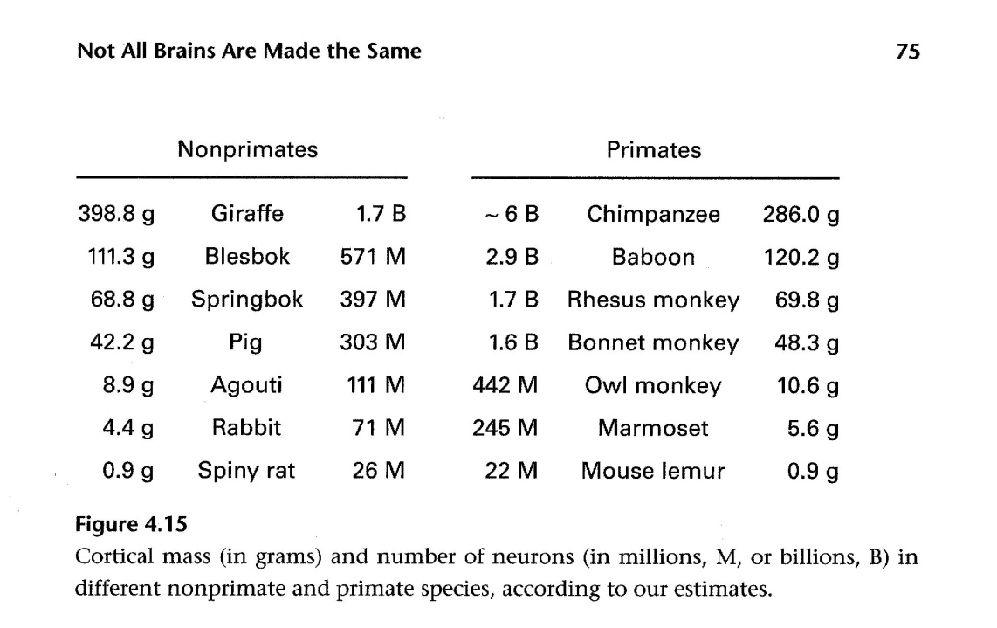

Slide 345
… SINE QUA NON
As far as I know, this peculiar phenomenon remains unexplained.
But without it, we would not have had room in our skulls for all of our 16 billion “comparative advantage.”

Slide 346
Natural (and, where present, sexual) selection never stops
CAPABILITY
Enabling good work

Slide 347
NATURAL & SEXUAL SELECTION ARE “ITERATIVE” PROCESSES (1)
Natural selection sometimes acts as singular, short-lived, “cash-on-delivery” events ―
things that happen immediately upon the arrival of a progeny equipped with some altered property (compared to those of other members of their generation) ―
and which blindly “decide” whether that progeny will live or die.

Slide 348
NATURAL & SEXUAL SELECTION ARE “ITERATIVE” PROCESSES (2)
But beware: this “winnowing out” process will be re-iterated
the moment something changes in the environment of this progeny’s own descendants
(such as some altered property in other members of its species)!

Slide 349
ALL PROPERTIES COME AT A COST
Worse still:
While only a scarce number of new, “random,” mutant properties will turn out to actually benefit the progeny
(i.e., enhance the chance of survival for it and its descendants),
any property of any living organism comes at a cost ―

Slide 350
NATURE IS A SCRUPULOUS COST/BENEFIT CONTROLLER
… and nature acts much as a scrupulous financial controller,
constantly monitoring the current cost/befit ratio of each of her “investments,”
and withdrawing them the moment they no longer pay off!
☹

Slide 351
11 HUNTER-GATHERER EINSTEINS? The “ultimate” evolutionary enigma of human cognitive capacity
CAPABILITY
Enabling good work

Slide 352
THE HUMAN BRAIN MAY BE NATURE’s MOST COSTLY ORGAN
This general “covering law” of the evolution of the species:
properties will rapidly disappear once their cost/benefit ratio sinks below a certain threshold
is particularly relevant in the case of the human brain which
despite its relatively small size
arguably is one of nature’s most costly organs ―

Slide 353
SOME SAY IT IS NOT “ENERGY EFFICIENT” AT ALL
… fueled at a “burden rate” covering some 20 % or more of our total consumption of energy (glucose).
(Some say our brain is not “energy efficient,” since it is not at all well insulated, and leaks a great deal of heat to its environment.)

Slide 354
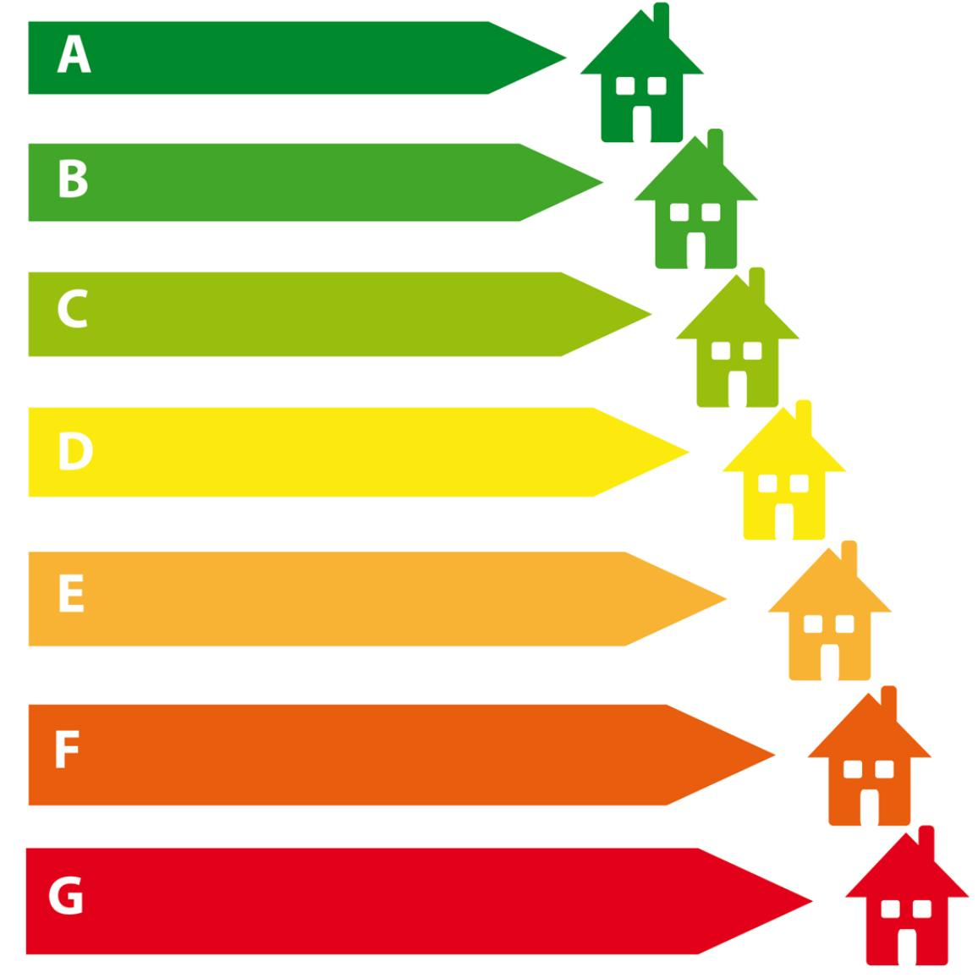
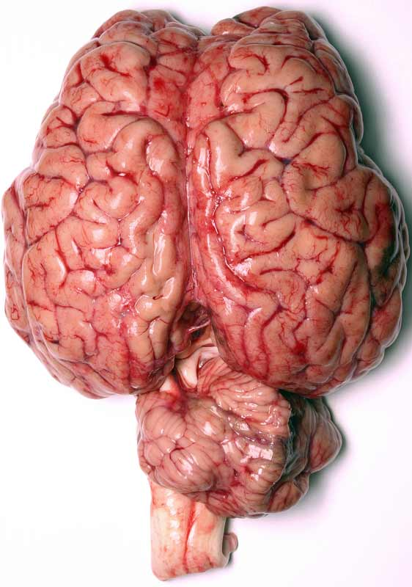

Slide 355
THE ENIGMA
And that’s the enigma which has troubled psychologists and evolutionary biologists for decades ― because:
Why on the earth would members of a species
that first emerged sometime about 200,000 (or perhaps even 300,000) years ago somewhere at an African continent which …

Slide 356
AFRICA DURING THE SAALE GLACIATION
… at the time must have been in the grips of the Saale glaciation
(estimated to have lasted from around 347,000 to around 128,000 years ago, i.e., having a duration of approximately 219,000 years ―
meaning that Lake Victoria, despite being so close to the Equator, probably would freeze over during winters) …

Slide 357
HUNTER-GATHERER EINSTEINS? (1)
… and who for more than 100,000 years (or perhaps more than 200,000 years) would sustain themselves as hunter-gatherers or scavengers
chose to sport a “cerebrum” topped with an extremely costly cortex
rapidly approaching (or perhaps already containing?) 16 billion neurons ..

Slide 358
HUNTER-GATHERER EINSTEINS? (2)
… meaning that folks back then
either were close to having or already had
the cognitive potential necessary for developing a highly abstract and, at the time, extremely impractical knowledge
such as, e.g., highly mathematized relativity theory and quantum physics?!

Slide 359
12 SOME HUMAN COGNITIVE ABILITIES MUST BE THE RESULT OF SEXUAL SELECTION
CAPABILITY
Enabling good work

Slide 360
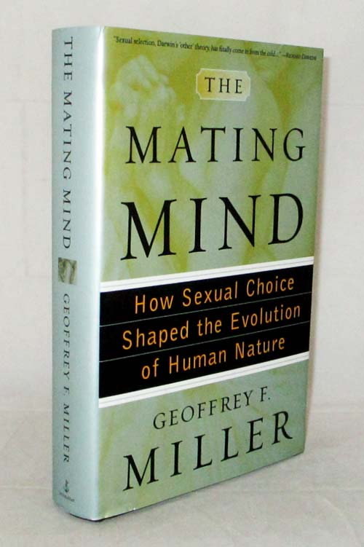

Slide 361
13 CODA The “ultimate” mechanism that drove the cognitive evolution of the Genus homo
CAPABILITY
Enabling good work

Slide 362
MY MOTTO (IN DANISH)
“Menneskets mentale system er vokset ud af naturen gennem en evolutionær proces, og vi må forvente i naturen at kunne finde fænomener, der minder om menneskelivet i alle dets former.
Ja, hvis dette ikke var tilfældet, måtte vi søge en teori, der kunne redegøre for, hvorfor vi skulle være så ekstraordinært særprægede væsener.”
― Jesper Hoffmeyer, 2005

Slide 363
THE “NATURALIST” APPROACH
“Materialism demands that we understand nature in such a way that there would be no absurdity in affirming that it produced us.”
― Isabelle Stengers, 1984

Slide 364
HOW DID EVOLUTION CREATE HISTORY?
Herculano-Houzel’s (proximate) findings are indeed pioneering work!
But they only make the ultimate questions more pressing:
How did evolution create (human) history?
What sort of natural and/or sexual selection mechanism(s) could possibly explain the genesis of a 16 billion neurons strong cortex?

Slide 365
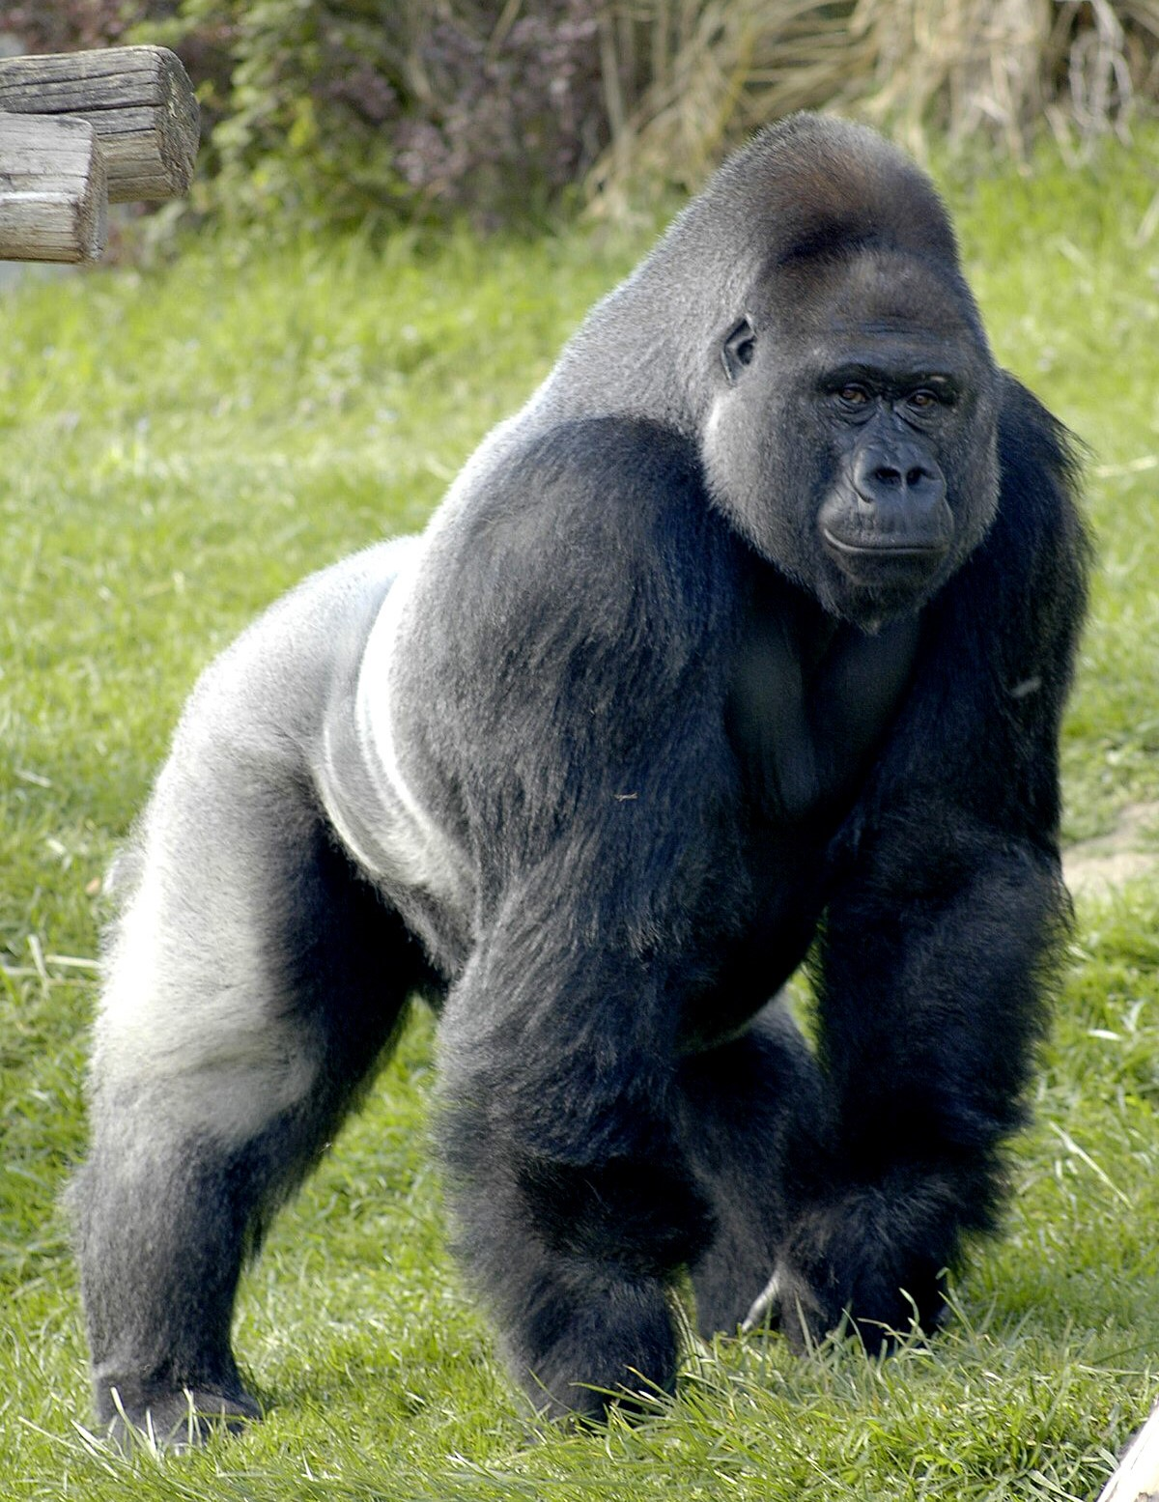

Slide 366
GORILLAS MUST EAT ALL DAY
Gorillas are herbivores: They eat raw leaves.
That’s not excessively nutritious ― and the animals’ digestion has a hard time extracting the necessary supply of energy from it.
This means that gorillas have to spend most of their waking hours eating ―
in order to sustain their rather heavy bodies:
Male gorillas may weigh up to 225 kg, and females up to 110 kg.

Slide 367
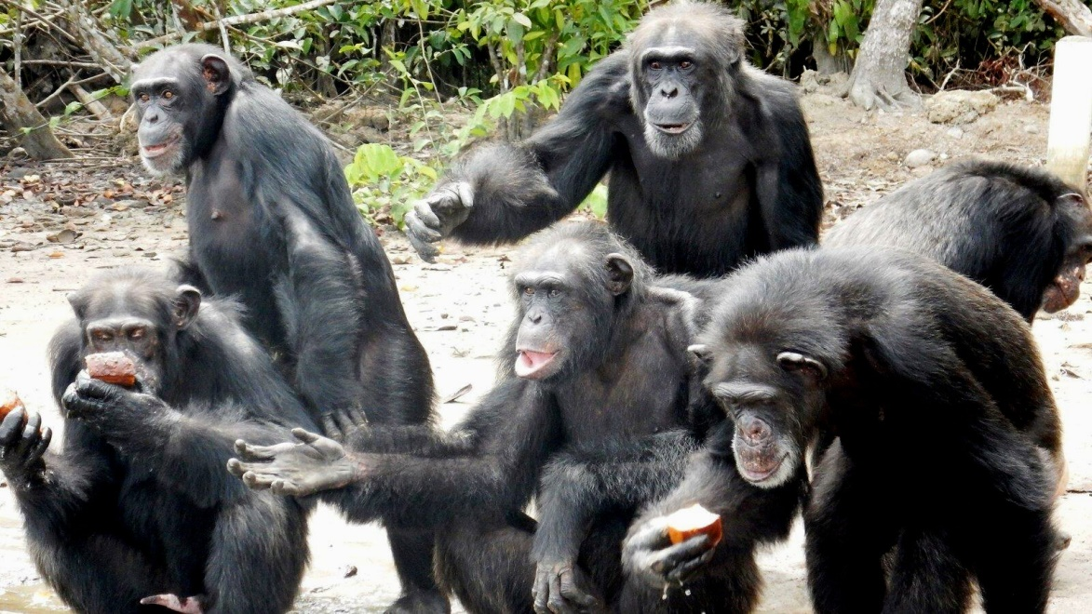

Slide 368
CHIMPS HAVE MORE TIME FOR LEISURE (1)
Chimpanzees, by comparison, indulge in a rich, mixed diet of
fruit, bird eggs, insects, raw meat (preferably from smaller primates), and
carrion [= decaying meat from corpses of dead animals]
which supplies their system with many more calories (kilojoules).

Slide 369
CHIMPS HAVE MORE TIME FOR LEISURE (2)
They, too, may spend many hours eating ―
but seem to have considerably more time for nurturing and caring for babies (strictly a female task!),
as well as for grooming, playing, and other social activity.
And they sleep nine or ten hours per night.

Slide 370
MALE CHIMPS ARE NEVER SEXUALLY FASTIDIOUS
Male chimps, by the way, are never sexually fastidious:
they appear to find any female equally attractive ―
but would never dream of lending a hand with the progeny.
(If anything, they will try to kill babies that are not their own.)

Slide 371
COULD A MUTATION CREATE A CHIMP WITH A HUMAN BRAIN? (1)
Now, for the sake of argument, let us imagine that,
due to a very rare, simultaneous occurrence of several genomic mutations,
a female chimp gave birth to a baby who
instead of growing a brain with the usual 6 billion neurons in its cortex …

Slide 372
COULD A MUTATION CREATE A CHIMP WITH A HUMAN BRAIN? (2)
… began to grow one destined to end up with a 16 billion ditto (like H. sapiens does) ―
what would happen then?

Slide 373
WELL FED, YET STARVING
The sad-but-simple answer is that:
even if the mother did her very best at breast-feeding her baby,
and even if she or he survived her first weeks and months,
at some time the poor thing would die
due to a malnutrition of sorts:
☹ ☹ ☹

Slide 374
NATURAL DE-SELECTION ☹
A diet of raw foods would not allow the chimp kid’s digestion system to supply its abnormally large, growing brain with the nutrition it needed ―
and natural selection would let the chimpanzee baby fall through its sieve
and into the abyss.

Slide 375
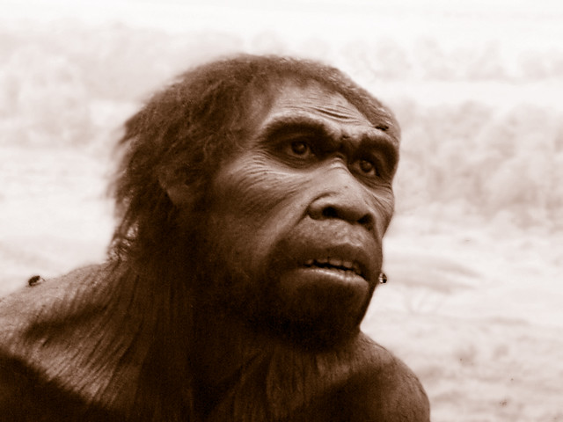

Slide 376
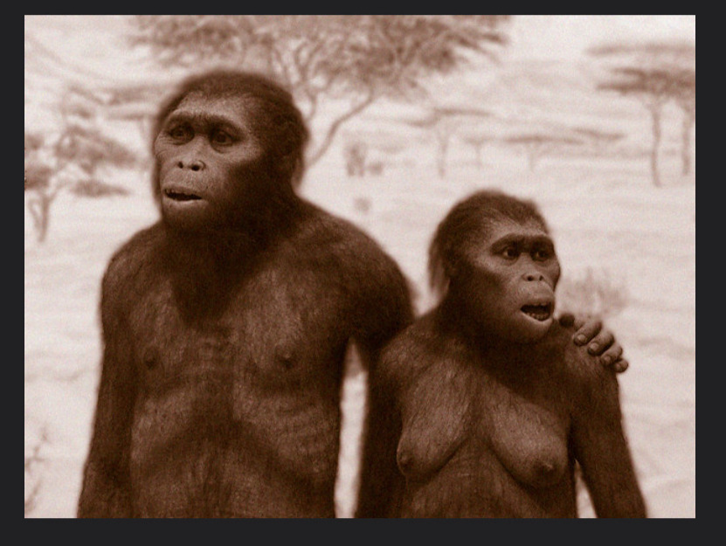

Slide 377
HOMO ERGASTER
But skulls of the Homo ergaster
who first emerged some 1.5 million years ago
suggest that they did not have the jaw muscles necessary for eating raw food ―
meaning that: they must have cooked or fried what they ate!
(“Homo ergaster,” by the way, means: Working man.)

Slide 378
THE BENEFITS OF COOK FOOD
Now, cooked food:
is easier and quicker to digest,
can be digested with a smaller gut,
reduces the time and energy required for chewing,
allows for the size of the jaw and teeth to be reduced …

Slide 379
A PRE-CONDITION FOR SPOKEN LANGUAGE
… thereby
freeing oral capacity for a greater range of vocalizations …

Slide 380
ALLOWING INDIVIDUALS WITH LARGER BRAINS TO SURVIVE
… but, most importantly, it
can release a supply of energy (glucose) necessary for a much larger brain ―
thereby allowing progeny that were the results of a possible series of genomic mutations which would do just that
to actually survive!
☺ ☺ ☺

Slide 381
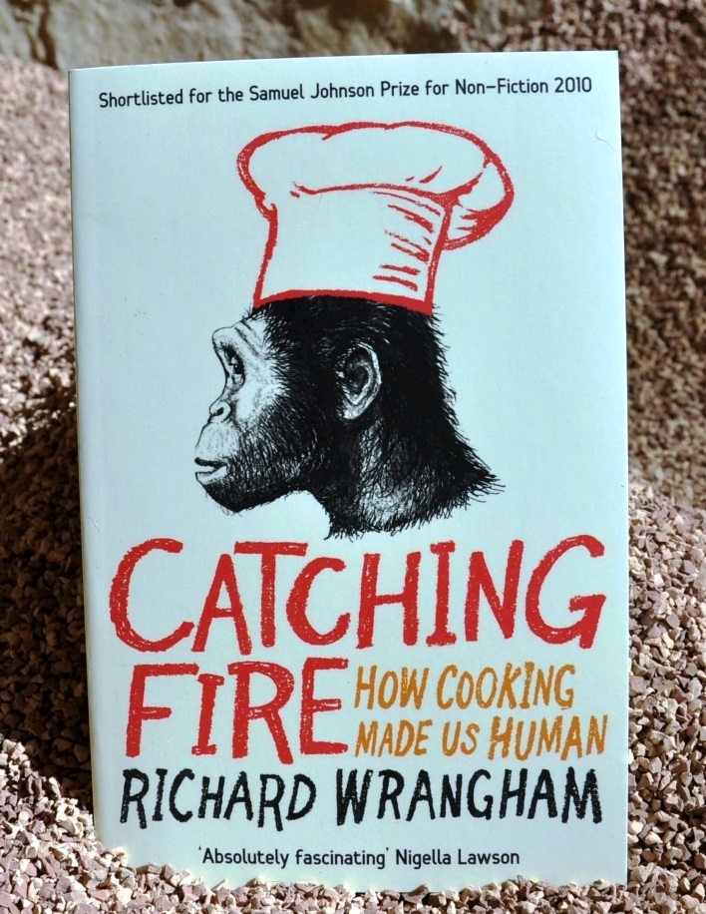

Slide 382
SOCIAL IMPLICATIONS
Wrangham argues that cooked food not only had an impact on human physiology,
but also may have led to a fundamental change in the nature of social relationships:

Slide 383
COOKING & GENDER ROLES? (1)
“Cooking is necessarily a conspicuous and lengthy process. In the bush, the sight and smell of smoke reveals a cook’s location at a long distance, allowing hungry individuals who have no food to easily locate cooks in action.
The effect among Homo erectus is easily imagined.”

Slide 384
COOKING & GENDER ROLES? (2)
“Because females were smaller and physically weaker, they were vulnerable to bullying by domineering males who wanted food.
Each female therefore obtained protection from other males’ wheedling, scrounging, or bullying by forming a special friendship with her own particular male.”

Slide 385
COOKING & GENDER ROLES? (3)
“Her bond with him protected her food from other males, and he also gave her meat.
These bonds were so critical for the successful feeding of both sexes that they generated a particular kind of evolutionary psychology in our ancestors that shaped female-male relationships and continues to affect us today.”

Slide 386
THE CENTRAL DOGMA STILL HOLDS (1)
This idea is not in any way at odds with what Francis Crick (1916-2004) dubbed “the central dogma” ― which (in my own private rendition) may sound as follows:
Information can travel from DNA via RNA into cell ribosomes, and thereby regulate the synthesis of proteins (and thus influence the design of cells, organs, and organisms) …

Slide 387
THE CENTRAL DOGMA STILL HOLDS (2)
… but no information can ever travel in the opposite direction.
(Mutations ― largely triggered by the background radiation of the universe ― are not information.)

Slide 388
CAUSAL LOOPS (1)
Any living organism will, to a smaller or larger extent, influence its environment, and
more so, the larger it is and/or the more populous its fellow species-members will grow.

Slide 389
CAUSAL LOOPS (2)
Consequently, the idea that some species may change those external circumstances which, in turn, exerts a “directional pressure” on them
has long been part & parcel of modern evolutionary biology
(and associated with the name of Marcus W. Feldman (b. 1942) from Stanford University).

Slide 390
PERORATIO
A few slides ago I asked: “How did evolution create human history?”
It seems we may just as well ask the reverse question:
“Has the technologies that we have invented influenced our biological evolution ― and how?”
(I rest my case. Thank you.)
☺

